Slide 2
Prospecting in Indian country
A Longitudinal Understanding of Tribal Nations in Research

Slide 3
Osage language exercise
𐓡𐓘𐓷𐓟

Slide 4
Osage language exercise
𐓰𐓘𐓡𐓟 𐓩𐓣͘𐓤𐓯𐓟
How are you?

Slide 5
Learning objectives
Attendees will gain insights on strategies to identify and analyze the unique philanthropic interests and obscure revenue streams of tribal nations to inform fundraising strategy
Attendees will learn about cultural and ethical considerations before approaching a tribe for partnerships or funding

Slide 6
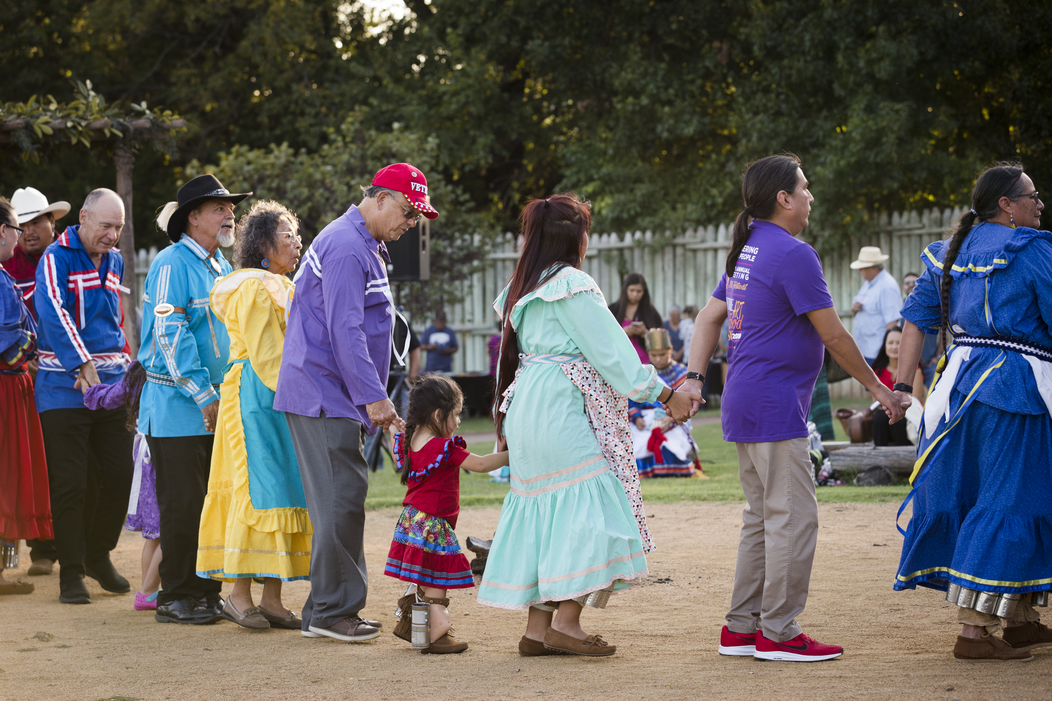
Session overview

Slide 7
History & Framework

Slide 8
Rich histories, modern contributions

Slide 9
What are tribal nations?
Sovereign Nations
Every tribe has a unique history, culture, and even government structure
Tribal sovereignty has existed since time immemorial
Federal Recognition
Required to gain gov-gov relationship and thus eligibility for millions of dollars in resources
Recognition can have a profound impact on tribes
Source: Domestic Policy Caucus

Slide 10
Source: US Census 2020

Slide 11
Source: Library of Congress

Slide 12
Tribal business & Philanthropy

Slide 13
Understanding Tribal businesses
True or False?: Tribes don’t pay taxes
True
Tribal Corp Benefits | Federal (IRA of 1934 / OIWA) Charter | Tribally Chartered | State Chartered
Tax Immunity | X | /
State/Fed Filings |  | / | X
Easy to Form |  | X | X
Index
X | Yes
/ | Yes…. With Conditions
Source: US Bureau of Indian Affairs; OCU Law Review

Slide 14
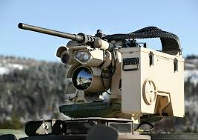
Where are the wealth indicators
Businesses
Voluntary Transparency
Federal contracts
USAspending.gov
Preference – Buy Indian Act

Slide 15
Wealth indicators
True or False: Tribes provide payments to their citizens
Trick question. Some do Per Cap, most don’t
Casinos
520 licensed gaming ops by 250 tribes in 29 states (Source: NIGC 2021)
State compacts / annual exclusivity fee reports

Slide 16
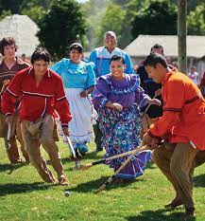
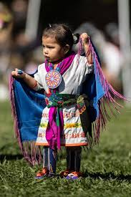
Gaming opens doors
Means to an end
People and Ways come first
Diversification for sovereignty and protection

Slide 17
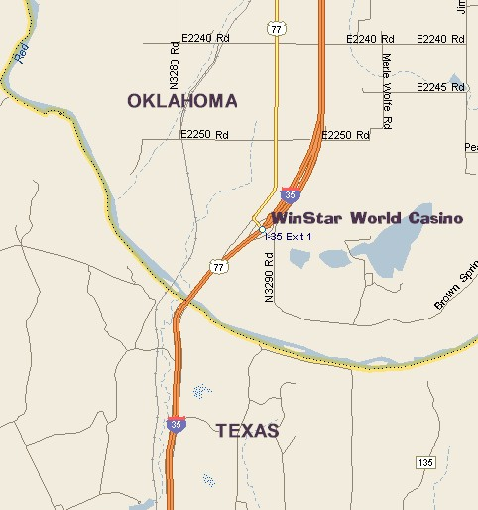
Gaming opens doors

Slide 18
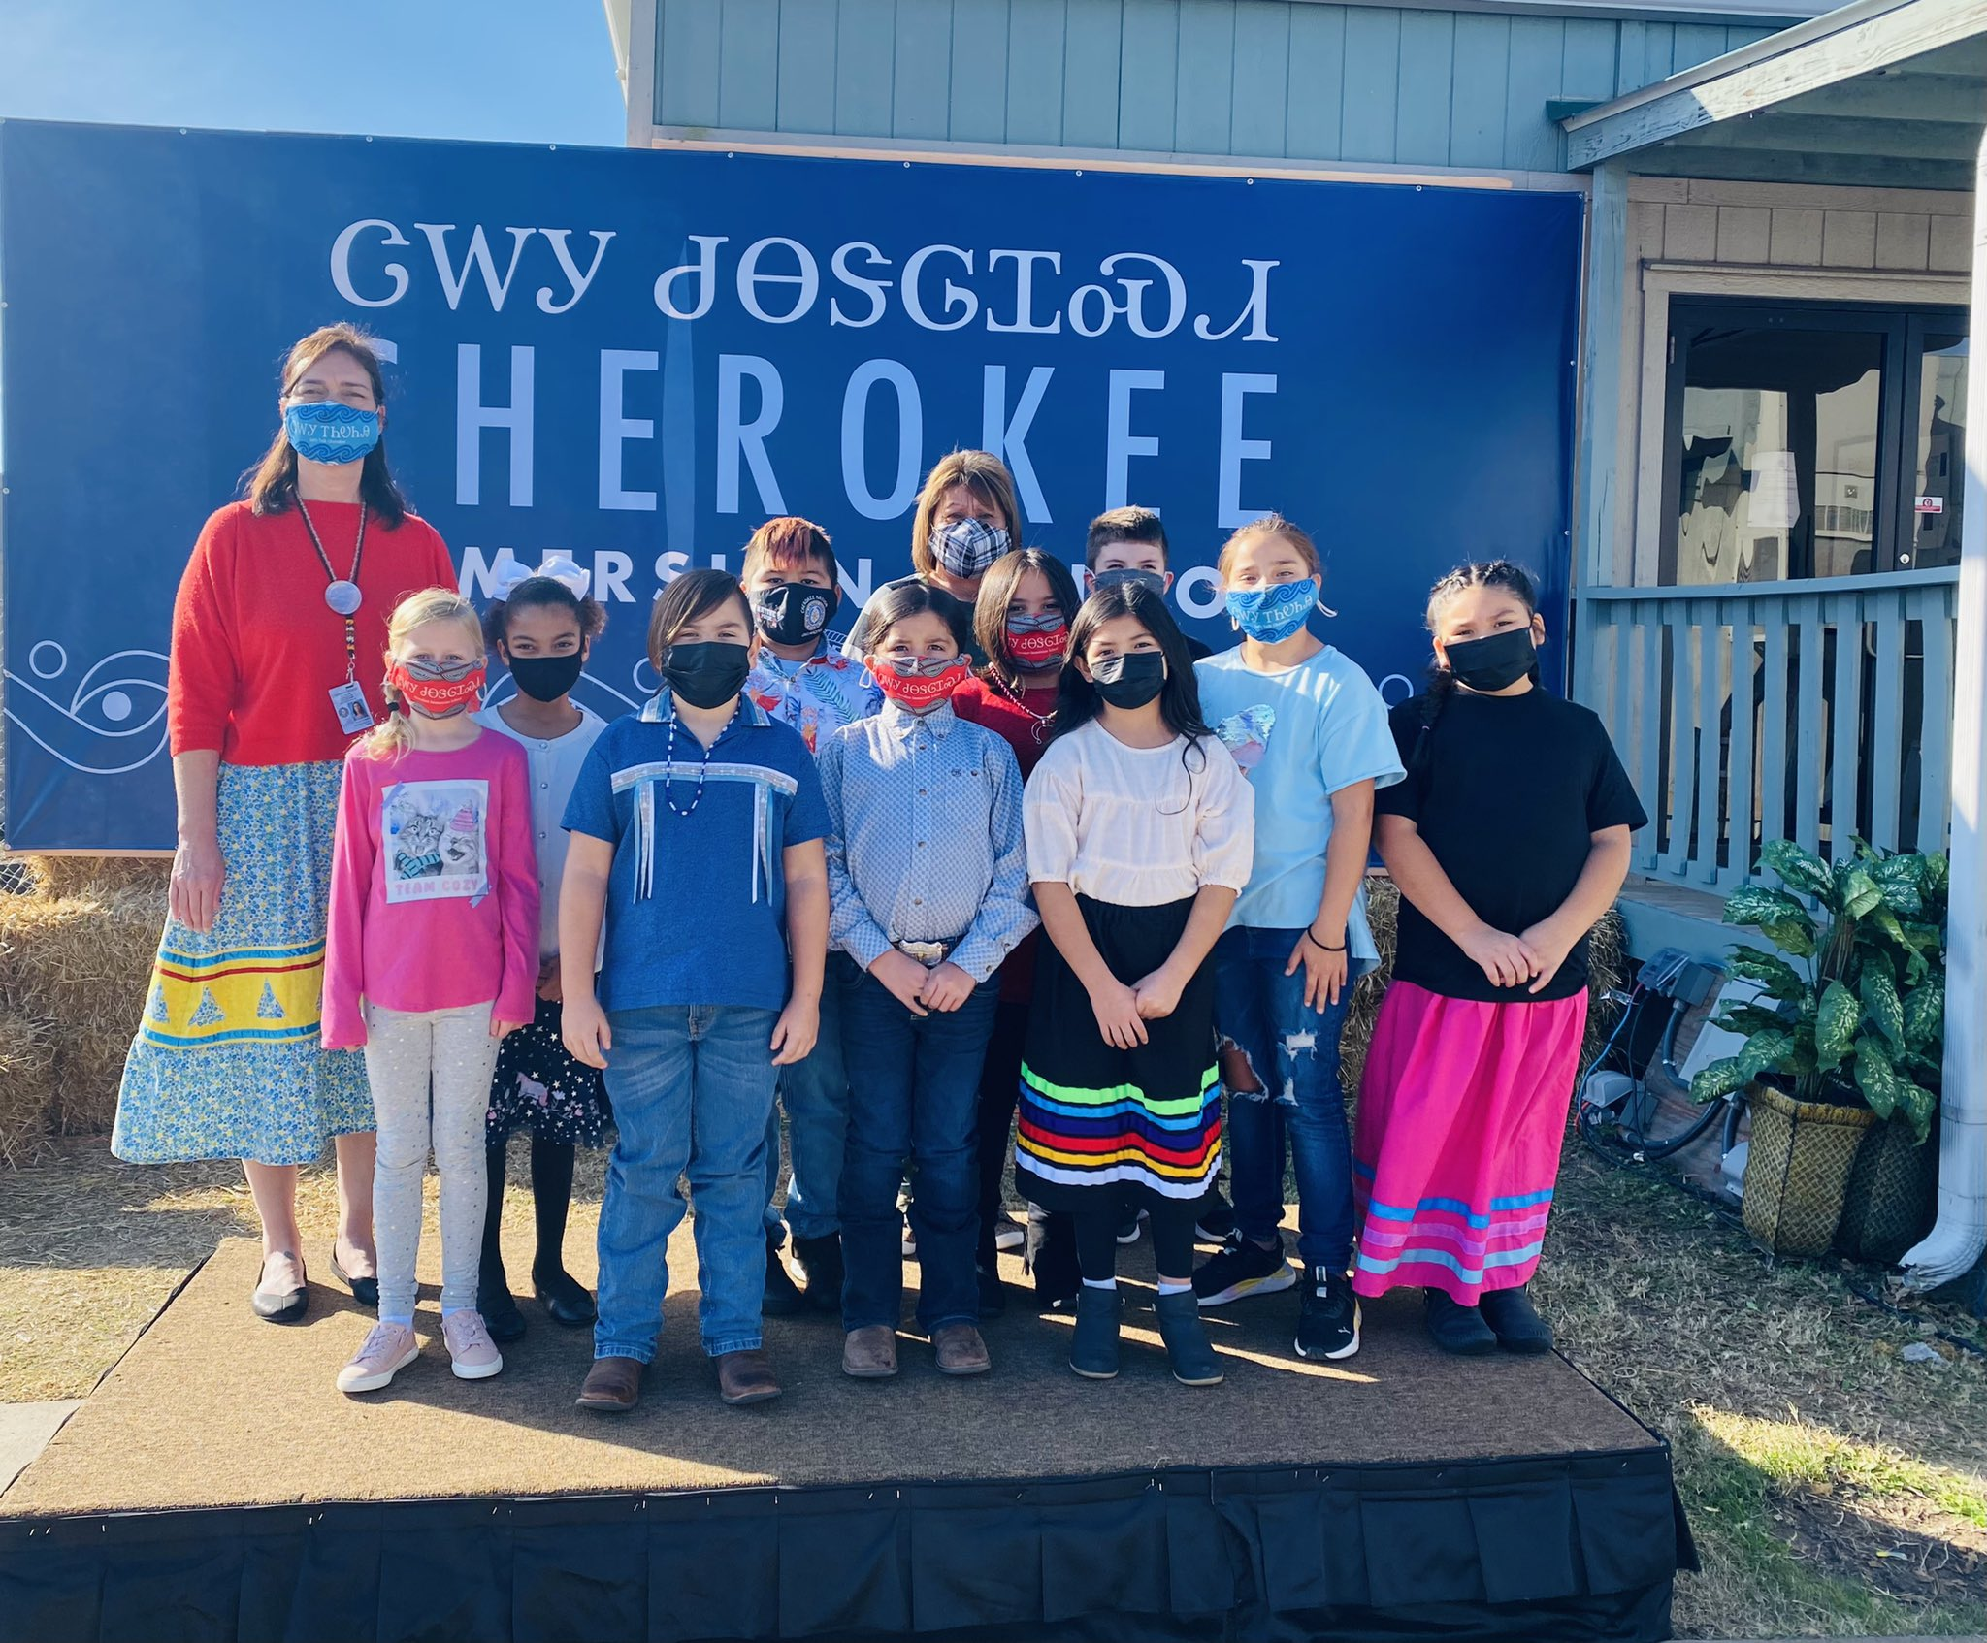
Philanthropic Indicators/Interests

Slide 19
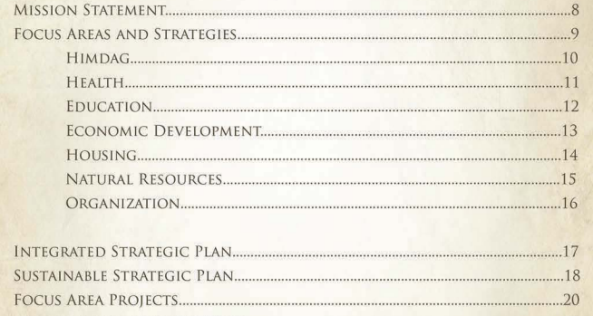
Philanthropic Indicators/Interests
Strategic Plans
Example: Tohono O’odham Nation

Slide 20
Philanthropic Indicators/Interests
Over-arching community considerations
Health disparities, suicide, language, culture revitalization
Each tribe is distinct and has its own challenges, needs, interests, economy

Slide 21
Examples in oklahoma

Slide 22
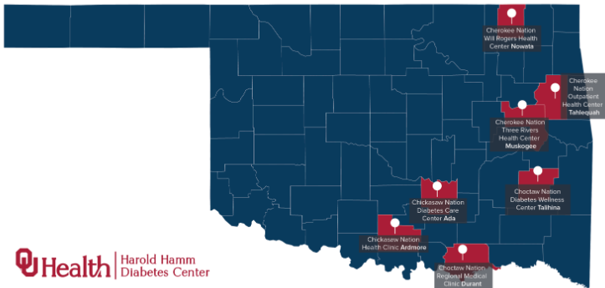
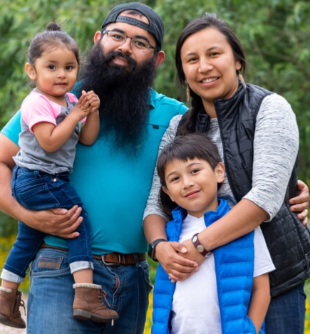
Examples in oklahoma

Slide 23
Examples in oklahoma

Slide 24
Ethical engagement

Slide 25
Ethical considerations
Don’t: Conduct Helicopter Research/Fundraising
Do: Exercise Patience, Engage at Executive Level & Seek Reciprocity
Educate yourself before meeting
Send your leaders to theirs
Respect Sovereignty & Self Determination
Reinforce their Priorities
See MSU’s Reciprocal Research: A Guidebook to Centering Community Partnerships with Indigenous Nations

Slide 26
Verifying Homelands

Slide 27
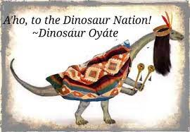
ethical considerations
Regional Partnership & Verifying Homelands
https://native-land.ca
Ethically identifying tribal citizens
Storage of data

Slide 28
Q&A
Takeaways:
Federal Recognition = great potential for capacity
Understanding a tribe’s history may reveal resources
Philanthropy often based around well-being of their people/nation, but tribal foundations and strategic plans can illuminate opportunities
Partnership & Reciprocity should play a role in donor-centric tribal engagement
Contact information:
Bhamm@ou.edu

Slide 29
Thank you!
Please complete your session evaluations in the mobile app.

