Slide 1
Enabling Advanced Analytic Tools and Access to Data
Bringing technology and people together for better analytics
A revamped session from Apra PD 2022
Notes:
1:05 presentation – 7 topics/26 slides
7 minutes ish on preferred topics
3-4 minutes ish on other topics
9:05 Emma intros
9:10 us intros/context agenda
9:18 topic 1
9:25 topic 2
9:33 topic 3
9:40 topic 4
9:45 topic 5
9:50 topic 6
9:55 questions

Slide 2
AGENDA
Providing actionable data
Encouraging strategic questions
Analyzing the “right” things
Creating strong partnership
Data access
Data definitions
Personalization vs. standardization
https://app.sli.do/event/7UxzvLb6QRj6C6VHJ71HKT/embed/polls/c94cdffc-21c6-4f63-ba58-ea8cb7bb872d
Notes:
https://app.sli.do/event/7UxzvLb6QRj6C6VHJ71HKT/embed/polls/c94cdffc-21c6-4f63-ba58-ea8cb7bb872d
<iframe src="https://app.sli.do/event/7UxzvLb6QRj6C6VHJ71HKT/embed/polls/c94cdffc-21c6-4f63-ba58-ea8cb7bb872d" width="300" height="400"></iframe>
We’ll keep all examples fairly high-level and philosophical/theoretical, so it’s less about you coming away and saying, “Now I know how to build a model to identify parent prospects” and more “Now I understand the concept of why/when/how to build a model to identify top prospects and can apply some of these principals to my org/job.” If you really want to dive in on any specific example we show, please follow-u with us later

Slide 3
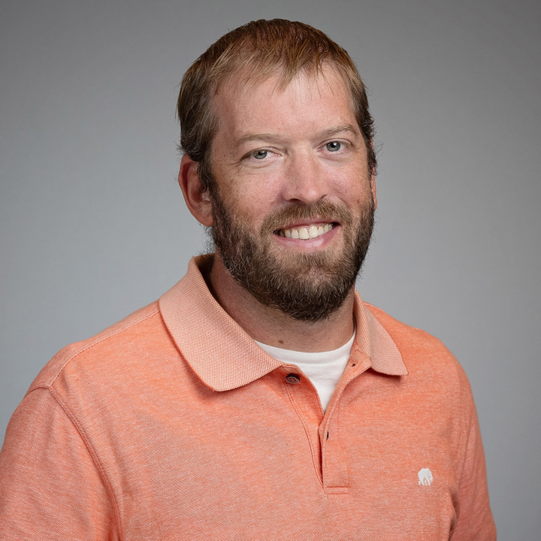
SPEAKER INTRODUCTIONS
Katie Princo
Assistant Director
Research & Analytics
12 years with CU
University of Colorado MMus in Composition ‘13
5 years of campus Advancement experience
5 years with the Research & Analytics team
The coolest thing I’ve done at CU:
Learn to use Python for analyzing spreadsheets too big for Excel
Aron Sage
Assistant Director
Business Intelligence
10 years with CU
Advancement & Central Information Systems experience
The coolest thing I’ve done at CU:
Built out Cognos Business Intelligence for Advancement

Slide 4
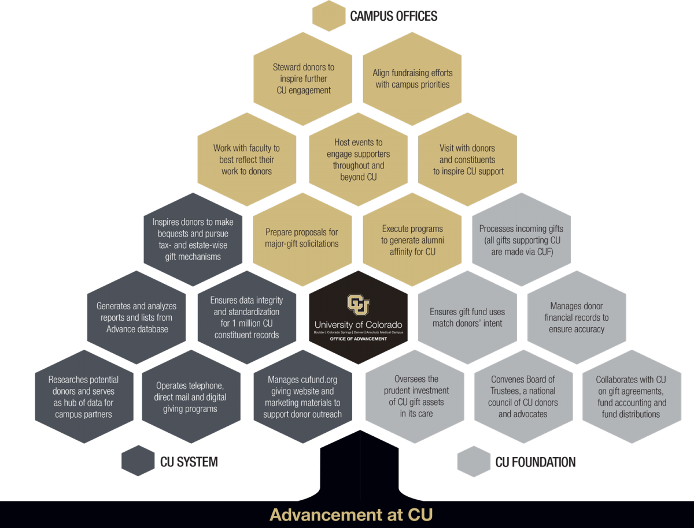
UNIVERSITY OF COLORADO INTRODUCTION
Decentralized reporting structure and campuses
Centralized Advancement support services
Often somewhat partially duplicated on the campuses
Other campuses:
CU Foundation
University of Colorado Boulder
University of Colorado Denver
University of Colorado Anschutz Medical Campus
University of Colorado Colorado Springs

Slide 5
TOPIC 1
How do you as a prospect development professional provide actionable data?
Aron’s perspective
Levels of access for different user groups
Tier 1 – Central Advancement key stakeholders – SQL access
Includes ad hoc training and code review
Tier 2 – Savvy campus users – data model access/pre-calculated fields
Tier 3 – Standard users – reports & dashboards – Ex. President’s fundraising dashboard

Slide 6
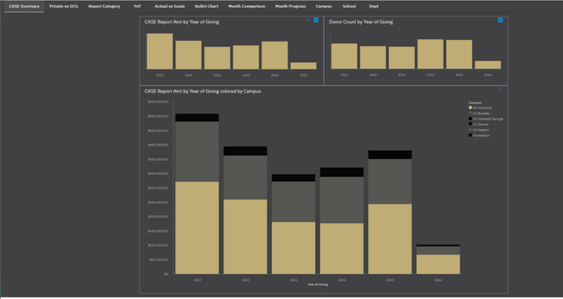
Example
CASE
Fundraising
Dashboard
Notes:
Moving toward more interactive dashboarding
Example of enterprise-level reporting, drill down into more details of the detail. Available for everyone to be able to access
Multiple tabs

Slide 7
TOPIC 1
How do you as a prospect development professional or other partner provide actionable data?
Katie
Ensure you understand context with standard research requests
Be willing to explore with them and try something new to fill their need!
Fundraising analyses – Ex. Anschutz college analyses
Notes:
Katie:
Two hats, researcher and analytics expert
Researcher – understand what they mean when they say “full body research request” lol
Researcher – understanding enough of the Advancement business to add in commentary – because you see this pattern in their giving, they haven’t yet considered major gifts at other institutions, so understand you’ll be training them on major giving, etc.
Analytics – understand why they want the data – what question are they answering and how do they plan to use this (share with people at an event to celebrate the impact of people in the room, identify new prospects, etc.)
A lot of time they don’t know what they’re asking for – ex. “Fundraising analysis” – and there’s a lot of advantages to being able to explore and help them figure out what’s useful, using our expertise

Slide 8
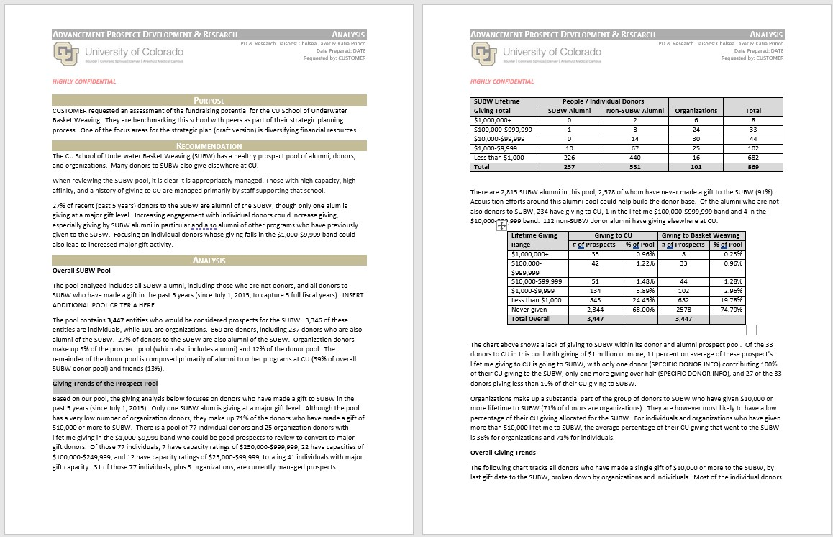
Example
Analysis
Request
Recommendations
Prospect pool
Giving trends analysis
Donor demographics
Counts of donors by gift band, dollars raised
Donor retention
Annual giving reports and insights
Unmanaged and managed prospect demographics

Slide 9
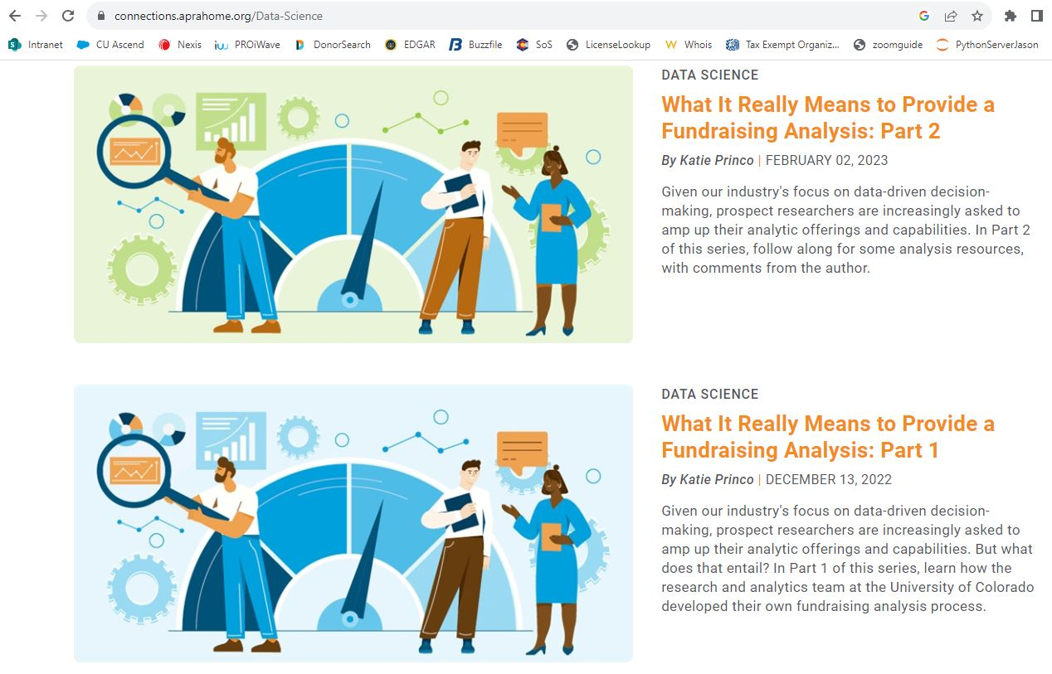
Check out Examples!
connections.aprahome.org/Data-Science
Part 1 – philosophy
Part 2 – Examples!
Sample analysis
Prospect analytics/identification video
Sample Prospecting excel

Slide 10
TOPIC 2
How do you encourage or influence your partners to ask strategic questions and ensure you can efficiently answer?
Aron
Asking questions
Figure out the problem they are trying to solve
Understanding where the data exists
Katie
Asking questions
Knowing our partners – Ex. Prospecting Plans
Notes:
Aron:
Identifying stakeholders
Walking through SOW requirement documents (later in presentation Topic 3)
Listening to what has already been done around the questions
Katie:
Knowing what their goals and definitions are
Example – campus partner ask for analysis of capacity, but noted that for these specific individuals, they had high capacity but primarily gave elsewhere on campus. The goal was to show that these individuals couldn’t meet the project goal based on this other giving
What do they expect the answer to be?

Slide 11
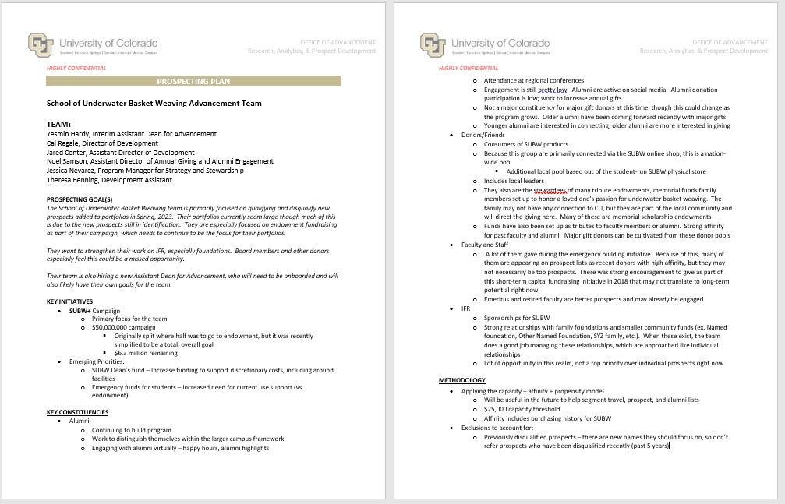
Example
Prospecting Plans
Team
Prospecting Goal(s)
Key Initiatives
Key Constituencies
Methodology
College Top Prospects
Regions
Historical Knowledge
Tools

Slide 12
TOPIC 3
How do you ensure you’re analyzing the “right” things without wasting time?
Katie
This will always be a challenge
Relates to the above (you have to know what question they’re trying to answer)
Struggles with acquiring the data – Ex. 1, Screening results analysis, Ex. 2, Parent data model
Notes:
Katie:
Time wasting piece – there are always rabbit holes, and you don’t know which ones are worth going down until you peek, so how do you peek and figure out scope without burning yourself out?

Slide 13
EXAMPLE
1,385,823 householded capacity results returned by vendor
1,383,725 householded existing results this was compared to*
2,295 Research Donor Scores and 336 Development Capacity Scores removed from analysis
1,112,225 households with new screening results and prior scores in Advance for comparison
298,232 scores increased (27%)
84,337 scores decreased (8%)
729,656 scores stayed the same (65%)
43,218 scores increased by 1 rating level
20,851 scores decreased by 1 rating level
There were very few scores that decreased overall this year. Last year there was a big shift with people being Unable to Rate increasing to the $2,500-$9,999 band. There don’t seem to be any big changes like that this year; the increased proportion appears to be reasonable.
The biggest shifts changing scores were:
Demographic changes:
I created pivot tables comparing how someone’s capacity changed (first column) compared to how demographic factors changed this year, such as real estate totals, count of real estate, # of states in which they own real estate, and SEC stock values. The trend below that seems interesting to me and perhaps worth investigating is…
Screening Analysis
Stats
Changes to scores
Demographic changes
Managed prospects with changes
Current Advance Score | New Vendor Rating | Count of affected households
7 ($2,500-$9,999) | 9 (Unable to Rate) | 200,937
7 ($2,500-$9,999) | Screened, No result | 19,300
7 ($2,500-$9,999) | 5 ($25,000-$99,999) | 15,568
6 ($10,000-$24,999) | 9 (Unable to Rate) | 14,727
5 ($25,000-$99,999) | 6 ($10,000-$24,999) | 12,226
5 ($25,000-$99,999) | 7 ($2,500-$9,999) | 13,524
5 ($25,000-$99,999) | 9 (Unable to Rate) | 11,568
4 ($100,000-$249,999) | 5 ($25,000-$99,999) | 11,320
Notes:
Huge amount of data
Focus on datapoints where there are likely to be changes/issues
High-level summary statistics
Things I create and SAVE to use later

Slide 14
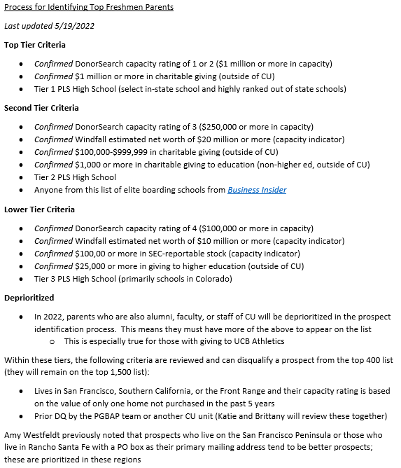
EXAMPLE
Parent Data Model
Notes:
Have this built in advance to just run so we don’t waste time during the process

Slide 15
TOPIC 3
How do you ensure you’re analyzing the “right” things without wasting time?
Aron
Low-fidelity approach – Ex. Low-fidelity diagram
Capturing requirement documents – Ex. Requirements document

Slide 16
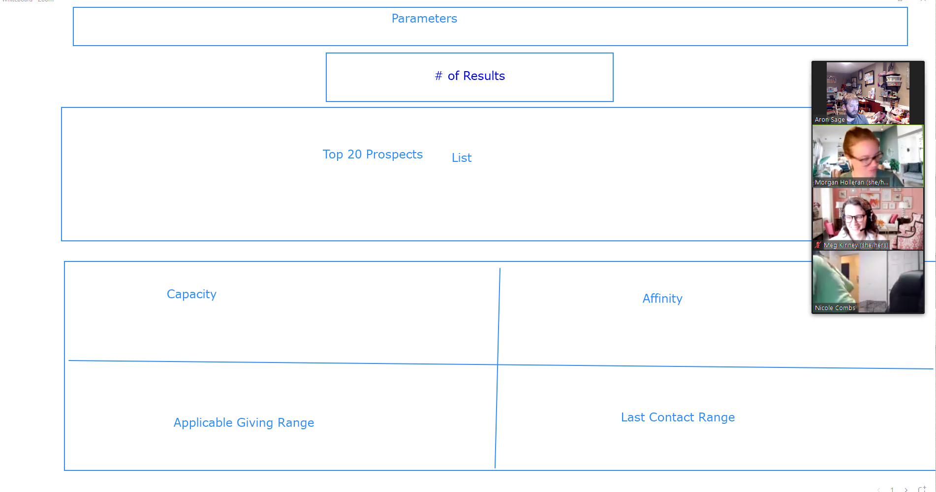
EXAMPLE
Low Fidelity Diagram

Slide 17
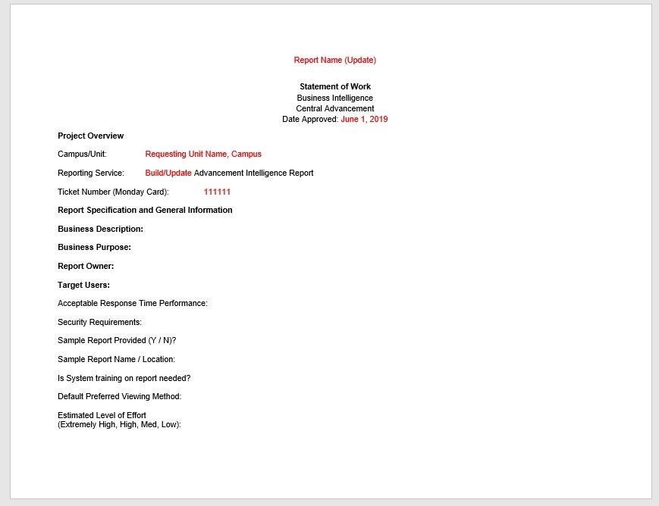
EXAMPLE
Requirements Document
Report overview
Report presentation
Stakeholders
Scope of work
Timeline
Team members
Report specifications

Slide 18
TOPIC 4
How do you get access to data without needing customized reports or help from other areas of the organization?
Aron
Updates to existing reports
Drill throughs
Providing access to data tools – Ex. Data modules
Remember – the data also changes, why does this look different now?

Slide 19
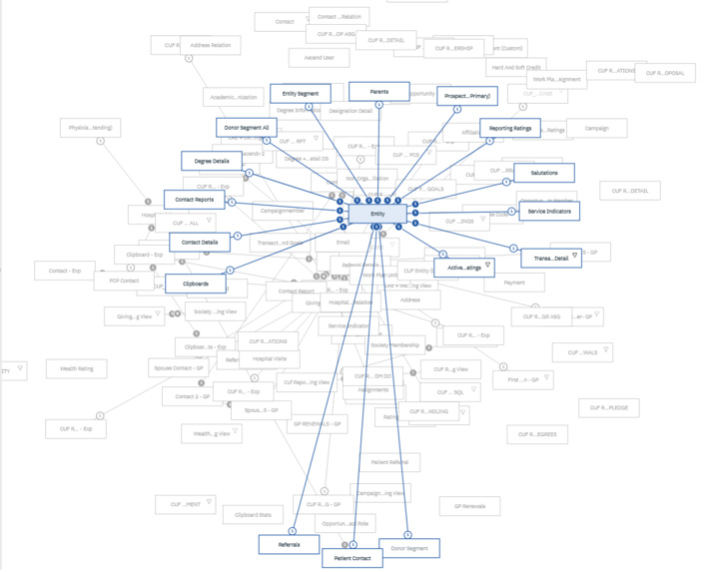
Example
Data Modules

Slide 20
TOPIC 4
How do you get access to data without needing customized reports or help from other areas of the organization?
Katie
Getting access to the back-end
Documenting our process and saving workbooks/data – Ex. Alumni dashboards
Remember – the data also changes, why does this look different now?

Slide 21
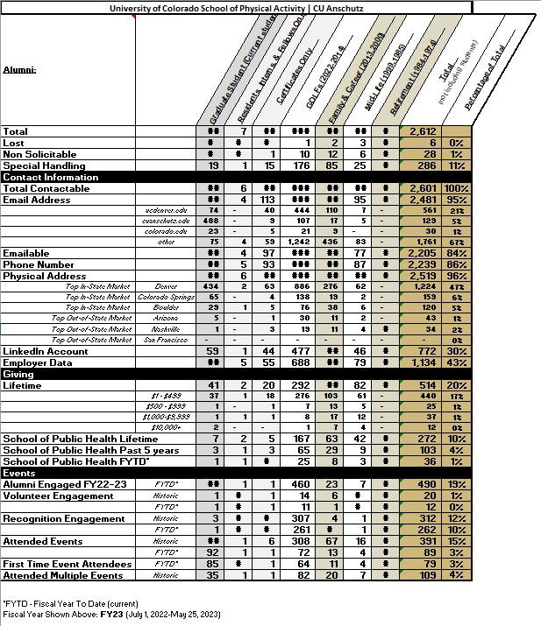
Example
Alumni dashboards

Slide 22
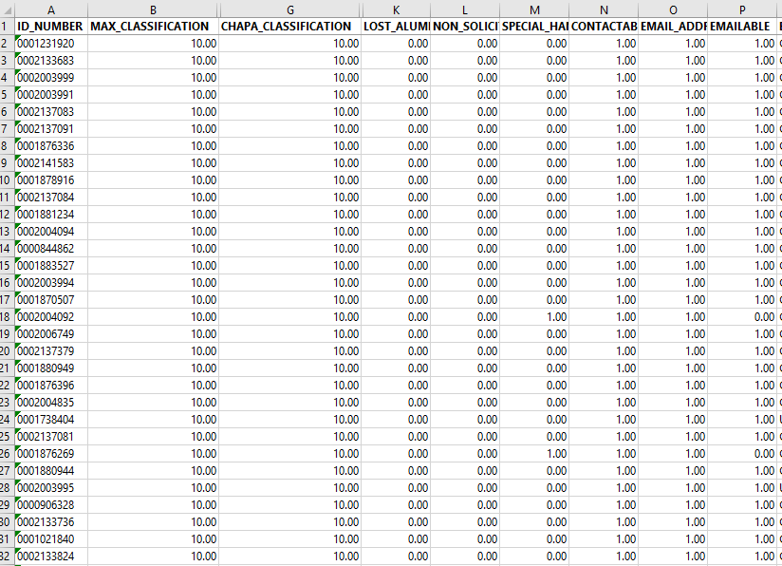
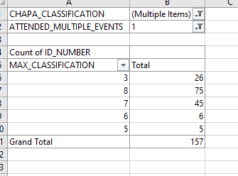
Example
Alumni dashboards
Notes:
Remember – the data changes, so when alumni disappear, check to see if they died, degrees reclassified, etc. – building the dashboard this way is way more manual but gave us ability to check our work and better verify everything

Slide 23
TOPIC 5
What datapoints have consistent definitions, and who decides what those definitions are?
Who makes the definitions?
Some at enterprise level – CASE standards, “alumni”
Defined by Steering Committee
Some at campus/unit level – “alumni”
Defined by partner
Pro tip: When enterprise-level definitions change, much more efficient to change the underlying data mart than to fix every single report
Notes:
When enterprise-level definitions change, much more efficient to change the underlying data mart than to fix every single report
Enterprise level – approved by ADC/governance – we don’t make the decisions, tailor to what you need for this one project because it will break things
BI = enterprise level, R&A = go to the campus definition level and explore with them

Slide 24
TOPIC 6
How do you tailor work to meet individual needs without overwhelming your team or other teams with personalization for different data?
Aron
Agile methodology
Adhering to requirement documents
Peer programming
Good leadership that creates space for developers
Katie
Recycle – code, processes, etc.
Create efficiencies
Peer knowledge sharing
Notes:
Aron:
Checking in on project multiple times a week
Bringing in other team members when there are blockers
Combined:
Stepping in to ensure the requestors are not increasing the scope of the initial project
Complexity of pulling certain datapoints
Inform campus partners of scope of accessing XYZ data – is this an existing standardized field that we can plop in in two minutes or are we building a new datapoint from scratch, and what is scope?
You could also be going outside of our teams to build a new standardized datapoint (i.e. involving tech arch) so what is impact/scope
Katie:
This is a huge struggle because we want to be the team that can go to the personalization level
Focus less on avoiding personalization and more on repurposing – code, processes, what someone else did, what someone else learned, etc.

Slide 25
TOPIC 7
Do you empower gift officers or other partners to do their own research/reporting/analytics? What are the pros & cons of doing so? How do you manage that?
Katie
Access to research tools – freebies and paid
Providing trainings on research tools
Providing trainings on best practices
Aron
Direct query access (for internal partners)
Providing BI/analysis tools to advanced analytics users (including campus partners)
We provide specific data models for different analytics groups
We provide ability to load external files into advanced analytic tools
Notes:
Katie
Yes – we offer trainings and talk about how they’re looking at raw data, this is where you’ll see pitfalls, when do you reach out to us, level of work

Slide 26
Questions and further discussion
Ask us anything!
If you come up with a question later, please feel free to reach out!
Aron.Sage@cu.edu
Katie.Princo@cu.edu
Thank you!

