Slide 1
The Value of Verifications
Apra North Texas
November 9, 2018

Slide 2
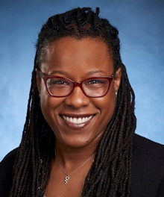
About Me
Director of Prospect Research Services at BWF
Located in Atlanta, GA
Previously:
Director of Prospect Research at Morehouse College
Assistant Director at Harvard University

Slide 3
Today’s Presentation
Lessons Learned
Value of Conducting Verifications
Verification Strategies
Define Verification
Value of Wealth Screening

Slide 4
Value of Wealth Screening

Slide 5
Goals of Wealth Screening:
Identify and verify new top prospects.
Understand wealth of database.
Predict future giving trends.
Help align fundraising plans and priorities.
Notes:
Insert three points. Summary of purpose and key items from proposal

Slide 6
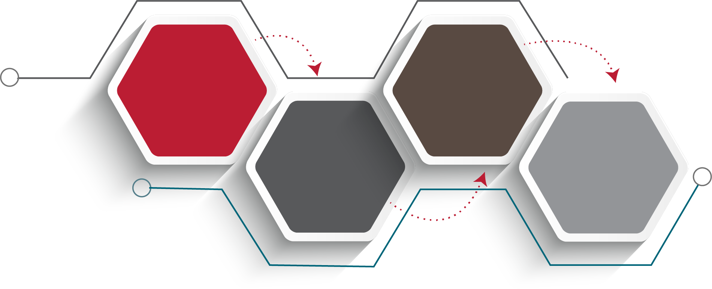
Typical Process:
Verification
Identify Major Gift Opportunities
Submit File
Assess Giving Capacity
Implementation

Slide 7
Wealth Screening Process:
Vendors typically screen your donor list using data from 30+ public and proprietary databases.
They then analyzes the returned data to find donors with both the inclination and capacity.
Client receives an excel export with key data on every prospect, ready to sort, filter, organize and output.

Slide 8
Define Verification

Slide 9
Purpose of Verification
Purpose of Verification:
What it is Not:
Estimate giving capacity over a 5-year period
1
1
Illustrate philanthropic inclination
2
Identify opportunities to engage

Slide 10
Components of Verification:
Capacity Rating System
Information Tracking Systems
Philanthropic Interests
Industry Expertise
Possible Engagement Opportunities
Relationships and Networks

Slide 11
Developing Standard Methodology:
Train research team
Define research resources
Create clear documentation
Create 15-minute process
Verification Methodology
Standardize wealth multipliers
Outline wealth sources
Create capacity ranges
Notes:
I made this up, make sure to review ☺

Slide 12
Methodology
Capacity Ratings Matrix:
Initial Rating | Stock* | Private Company Sales** | Income | Property | Other Gifts
$10M | $67M+ | $100M+ | $100M+ | $67M+ | $10M+
$5M | $33M–$66.9M | $50M–$99.9M | $50M–$99.9M | $33M–$66.9M | $5M–$9.9M
$2.5M | $25M–$32.9M | $25M–$49.9M | $25M–$49.9M | $17M–$32.9M | $2.5M–$4.9M
$1M | $10M–$24.9M | $10M–$24.9M | $10M–$24.9M | $6.7M–$16.9M | $1M–$2.49M
$500K | $5M–$9.9M | $5M–$9.9M | $5M–$9.9M | $3.3M–$6.69M | $500K–$999K
$250K | $2.5M–$4.9M | $2.5M–$4.9M | $2.5M–$4.9M | $1.65M–$3.29M | $250K–$499K
$100K | $1M–$2.49M | $1M–$2.49M | $1M–$2.49M | $1M–$1.64M | $100K–$249K
$50K | $250K–$999K | $500K–$999K | $500K–$999K | $750K–$999K | $50K–$99K
$25K | $75K–$249K | $250K–$499K | $250K–$499K | $500K–$749K | $25K–$49K
*Varies based on diversification of holdings.
**Private Company Sales: Use only if rating Owner, President, or CEO.
Notes:
Note that this hasn’t been adjusted from $1M calculation for property
RE:
Calculation: 15% of all properties (if 2+) or 1 property (if $1M+ value); 5% of property under $1M
Stock:
Calculation: Multiply the total number of shares directly owned by the current market price, apply 33%
Private company:
Calculation: apply 10% of sales
Other assets:
Calculation: 3 times any gift in a single year or 1 to 1 on any multi-year pledge, 10% of net worth, assets (foundation, etc.)

Slide 13
Prospect Verification Skillset:
Knowledge and utilization of research resources.
Wealth screening tools: ResearchPoint, WealthEngine, DonorSearch, iWave, etc.
Network and relationship mapping: Prospect Visual, Relationship Science, BoardEx, NodeXL, etc.
Interest identification.
Financial capacity evaluation.
Ability to make a decision on a prospect quickly.
Written and verbal communication.
Project management.

Slide 14
Verification Strategies

Slide 15
Verification Strategies
Gather Key Identifiers
Determine Time Allotment
Define Deliverable
Conduct Dud Screening

Slide 16
Verification Strategies
Ratings, Rationale, Links (not narrative)
Dead or Alive?
Is this the right person?
Wealth Points Hierarchy

Slide 17
Lessons Learned

Slide 18
Taking My Own Advice…
1
Do not go down the prospect research rabbit hole
2
Add a Needs More Research flag for names that need more than 15 minutes
3
Add a Warning flag for names that your organization should be careful pursuing
4
Conduct a mass dud screening. Look for common names and 20+ properties
5
Keep a timer to help stay on track
6
Create a Reviewed, Not Rated to quickly move past low capacity names
7
Create an Unable to Rate to identify names that do not have enough concrete information for a rating.

Slide 19
“Mass Dud Screening”
Screened Rating Source | Total Property Count | Total Property Value | Rating/Comment
Real Estate | 1 | $1,534,864 | For Verification
Real Estate | 5 | $2,984,930 | “2 Minute Rule”?
Real Estate | 32 | $15,980,762 | Reviewed, Not Rated
Real Estate | 3 | $11,138,974 | For Verification
Real Estate | 21 | $9,855,121 | Reviewed, Not Rated

Slide 20
Value of Verifications

Slide 21
DonorSearch Methodology
BWF conducted a comparative analysis of vendor screened capacities and BWF verified capacities for over 500 records.

Slide 22
Findings:
In cases of exact matches, screening ratings continue to be slightly higher than verified ratings.

Slide 23
Findings (Continued)
Verification is especially helpful at the highest capacity levels even in instances where the screening rating is within one level of the verified level, as at the highest rating levels this can still amount to 8-figure differences.

Slide 24
Findings (Continued)
BWF was able to discover substantially greater philanthropic capacity for individuals screened at every capacity level.
BWF was able to discover substantially greater philanthropic capacity for individuals screened at every capacity level.

Slide 25
Findings (Continued)
BWF found substantial examples of inflated capacity among constituents who screened at the $500K+ levels.

Slide 26
Findings (Continued)
Records with a “Y” Foundation Flag match were slightly Foundation Flag (4.5x) more likely to have their screened capacities be exact or close matches with verified capacity. The “M” Foundation Flag did not have the same likelihood factor.
Adding Middle Initial, Age, or Spouse First Name to the screening file did not significantly impact the likelihood for that record to be a close or exact match between screened and verified capacities.
Records with matches for charitable contributions, political gifts, SEC Insider (Y or M), or multiple real estate matches were no more or less likely to be Exact or Close matches to the BWF Verification.

Slide 27
iWave Methodology
BWF conducted a comparative analysis of vendor screened capacities and BWF verified capacities for over 170 records.
Two Dimensional Analysis of Screening Rating Source (real estate; political giving; income; charitable giving) compared to:
Likelihood of screening rating to be accurate
Likelihood of verified capacity to be at $100K+

Slide 28
iWave Methodology
Research verification confirms that approximately 50%-75% of screened capacities are either accurate or within one capacity level. Therefore we can confirm that screening ratings are accurate enough to add real value for prioritizing large data sets where capacity information is not otherwise known.
Notes:
Therefore we can confirm that screening ratings are accurate enough to add real value for prioritizing large data sets where capacity information is not otherwise known.

Slide 29
iWave Methodology
Screening matches will underestimate true capacity in 1 out of every 10-15 prospects, whereas verification may turn up substantial capacity here.
Notes:
Therefore, to increase the likelihood of discovering major capacity where it exists (especially in cases missed by screenings), records with charitable or political contributions matches can be prioritized for verifications.

Slide 30
iWave Methodology
Records that screened with charitable contribution matches were more likely to have higher verified ratings than initial screened rating.

Slide 31
iWave Methodology
Records that screened with political contributions were more likely to have higher verified ratings than the initial screened rating.

Slide 32
DonorSearch and iWave
About 1 in 4-5 records with high screening capacity matches are inflated. These capacities will be downgraded two or more levels after verification or qualification efforts.

Slide 33
Questions?

Slide 34
Contact
BWF lnsight
Comprehensive custom prospect development and analytics services.
Team of experts working toward innovative, best-in-class solutions for nonprofit organizations.
7251 Ohms Lane
Minneapolis, MN 55439
(952) 921-0111
www.bwf.com
Roslyn Clarke
Director of Prospect Research Services rclarke@bwf.com
Notes:
Ask CS to insert photos and info

