Slide 1
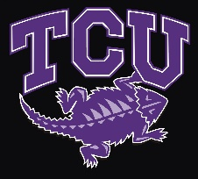
Demystifying Donor-Advised Funds
Dennis Alexander
Director of Foundation Relations

Slide 2
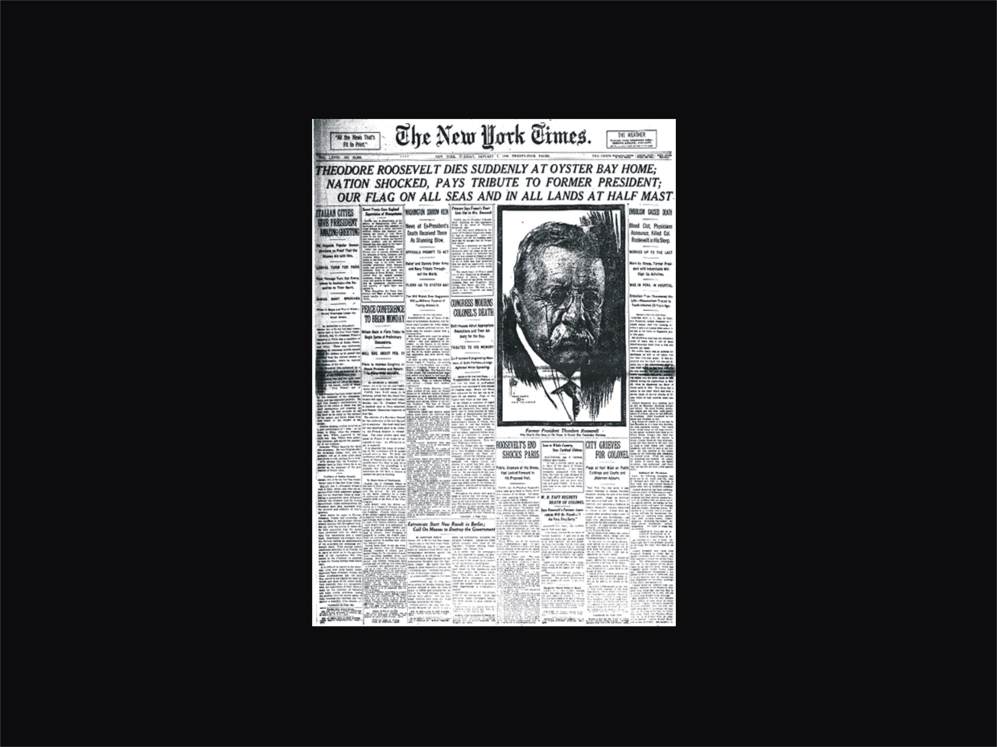
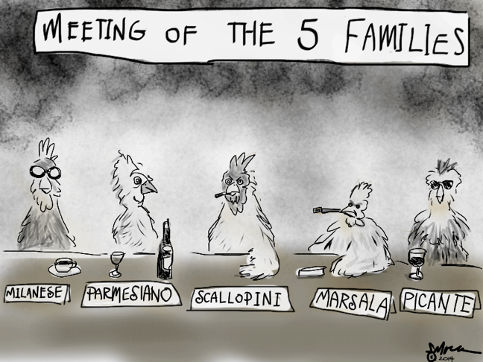
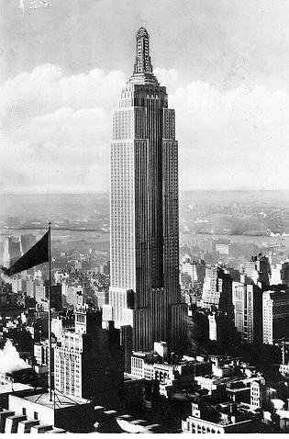
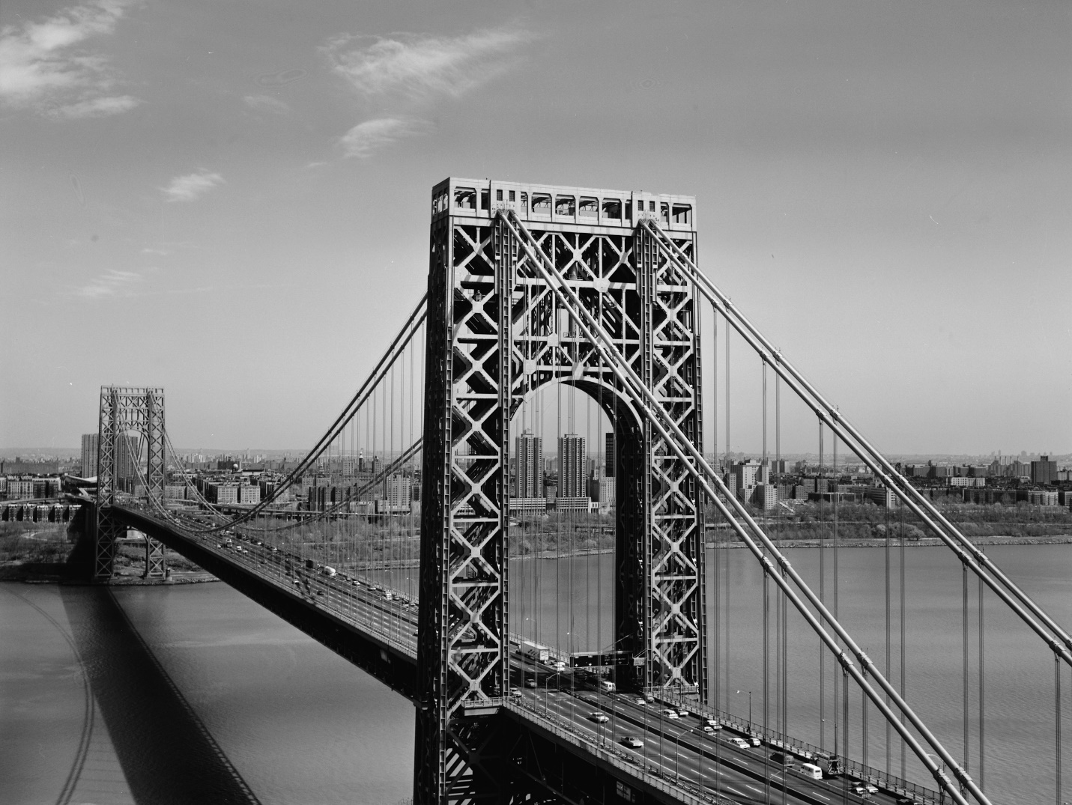

Slide 4
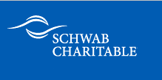
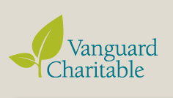

Slide 5
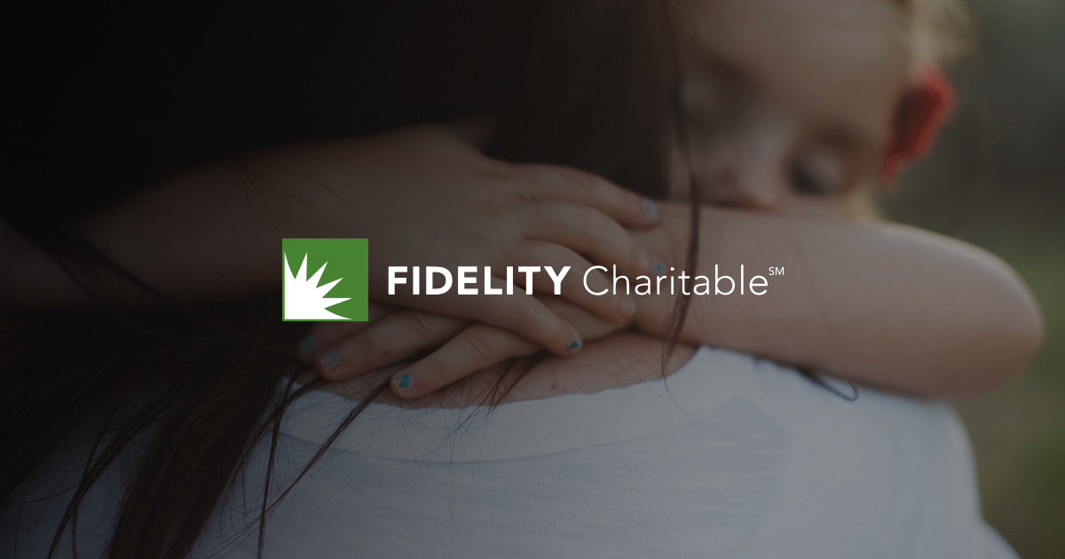
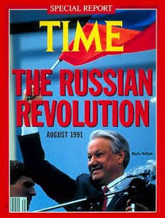
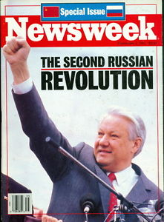
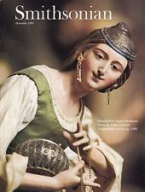
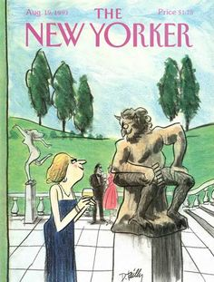

Slide 6
What is a Donor-Advised Fund?
DAF is a charitable bank account held by sponsor-ing organization
Donor reserves money for charity by depositing into account
Donor recommends charitable distributions to sponsoring organization
What is a Foundation?
Foundation is a nonprofit corporation or non-exempt charitable trust
Donor creates investment portfolio / endowment
Foundation distributes earnings to charity by donor decision

Slide 7
DAF Qualifiers
Donor neither owns nor controls DAF assets
DAF is owned/controlled by sponsoring org
Donor is advisor, not decision-maker
Limited flexibility (narrowly defined charitable giving options / limited discretion)
Foundation Qualifiers
Foundation is a “person” with its own assets
Donor does not own assets, but controls them
Donor is decision-maker, not advisor
Very flexible (broad charitable giving options / broad discretion)

Slide 8
Advantages of DAF over Direct Giving
Immediate tax deduction on money placed into DAF
Loads more tax deductions into high-income years
Money can be distributed gradually; more time to explore and vet charities

Slide 9
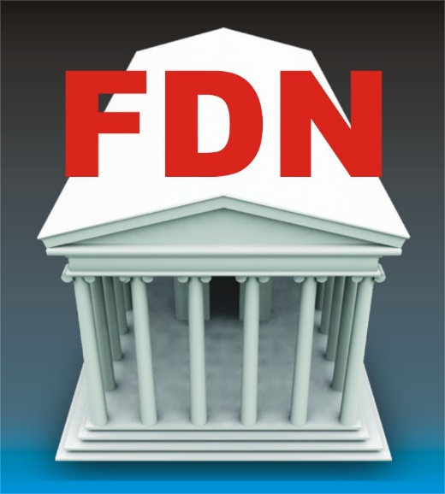
Set-Up
Simple and virtually immediate
Like opening a bank account
May take weeks or months
Must file with state and IRS
“Streamlined setup” in as little as 3 days

Slide 10
Startup Cost
Possible legal fee to review contract
Cost basis as little as $5,000
Legal + accounting + investment fees
Cost basis = $250,000 to $2 million / $3 million

Slide 11
Operating Cost
Sponsoring organization charges administrative & investment fees
≈1% of asset base/yr
May not use DAF assets to cover operating costs
Hired staff or fee-based financial institution
≈2.5-4% of asset base/yr
Foundation may charge operating costs to its own asset base

Slide 12
Capitalization
Primarily cash or negotiable securities
Other assets are problematic
Cash and negotiable securities
Tangible & intangible property
Real estate
Life insurance & annuities
Retirement assets
Estate gifts
Alternative investments

Slide 13
Maximum Tax Deductibility
60% of AGI for cash
30% of AGI for all other assets
Appreciated assets are deductible at current market value
30% of AGI for cash
20% of AGI for all other assets
Appreciated assets are deductible at cost basis only

Slide 14
Tax Liability
None
1-2% annual excise on net investment return

Slide 15
Charity Distribution Requirements
No legal requirement
Some sponsoring organizations self-impose minimum distributions
By law, minimum 5% of asset market value per year

Slide 16
Governance / Control
Donor releases all ownership & control
Advises but does not decide on distributions
Donor has little or no role in investment decisions
Donor releases ownership, but not control
Donor has complete fiduciary discretion
Applies to both gift & investment decisions

Slide 17
Family Legacy
Limited or non-existent
Most sponsoring organiza-tions enforce sunset rules
DAF remaining assets become sponsoring org’s discretionary assets
Unlimited
No sunset requirement; may exist in perpetuity
Foundation may employ family on staff or appoint to Board

Slide 18
Privacy
Complete privacy
Only limited privacy possible

Slide 19
Flexibility
Cannot make a binding pledge with a DAF
DAF may give to qualified 509(a) charities only
DAF may not make international grants
May commit foundation to a binding pledge
Grants to virtually anyone for charitable purposes
Foundations may give worldwide

Slide 20
Criticisms of DAFs
Inhibits fundraising; donors inaccessible
Minimal transparency / disclosure (Allows “creative bookkeeping”)

Slide 21
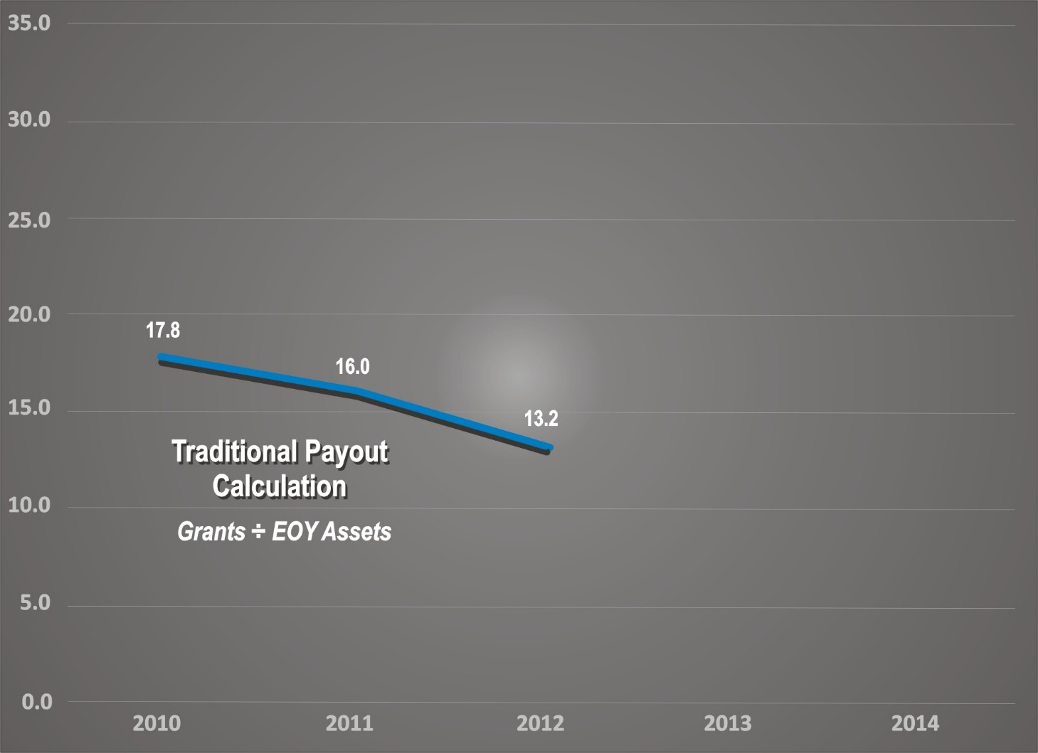
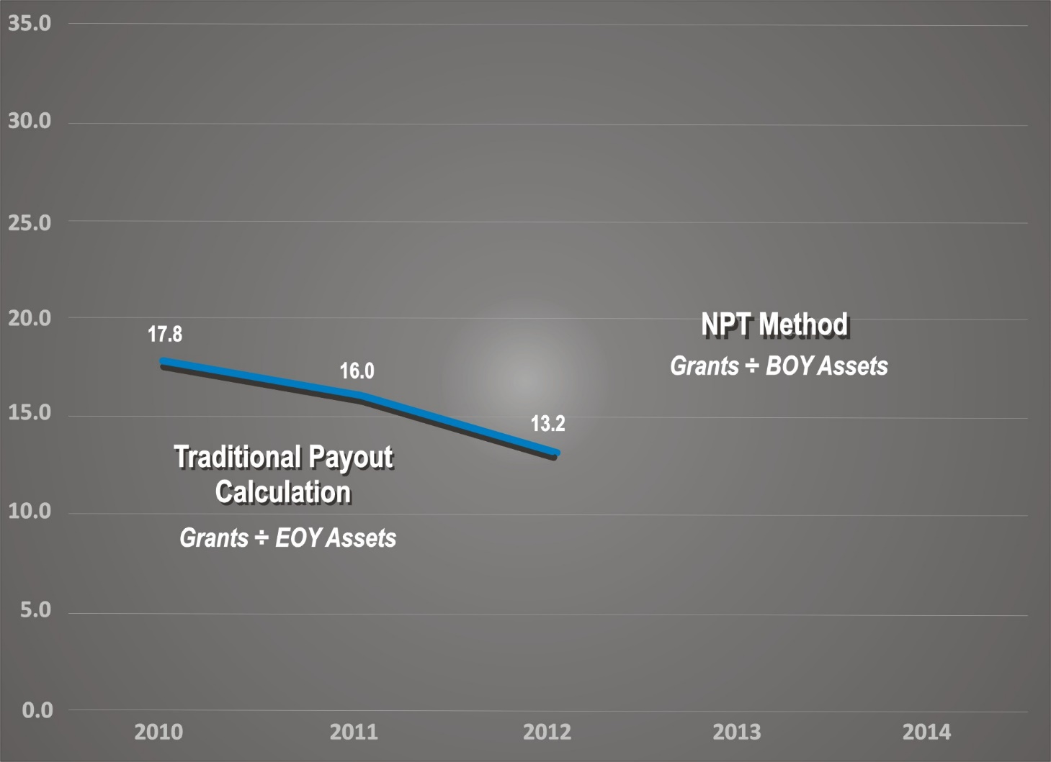
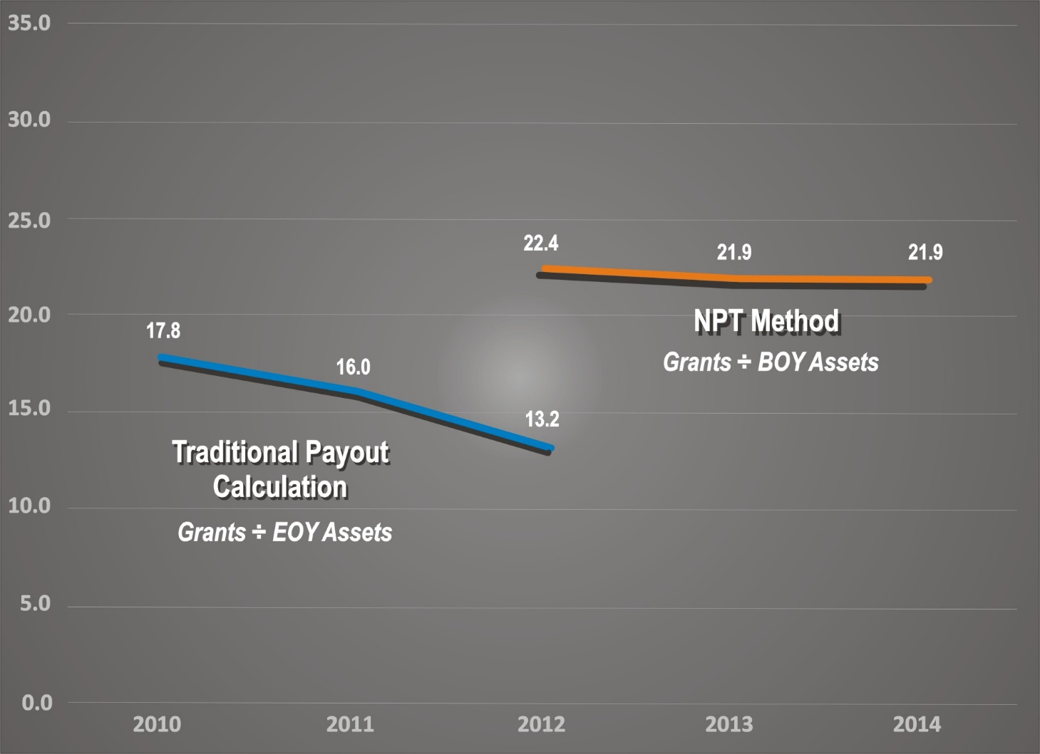
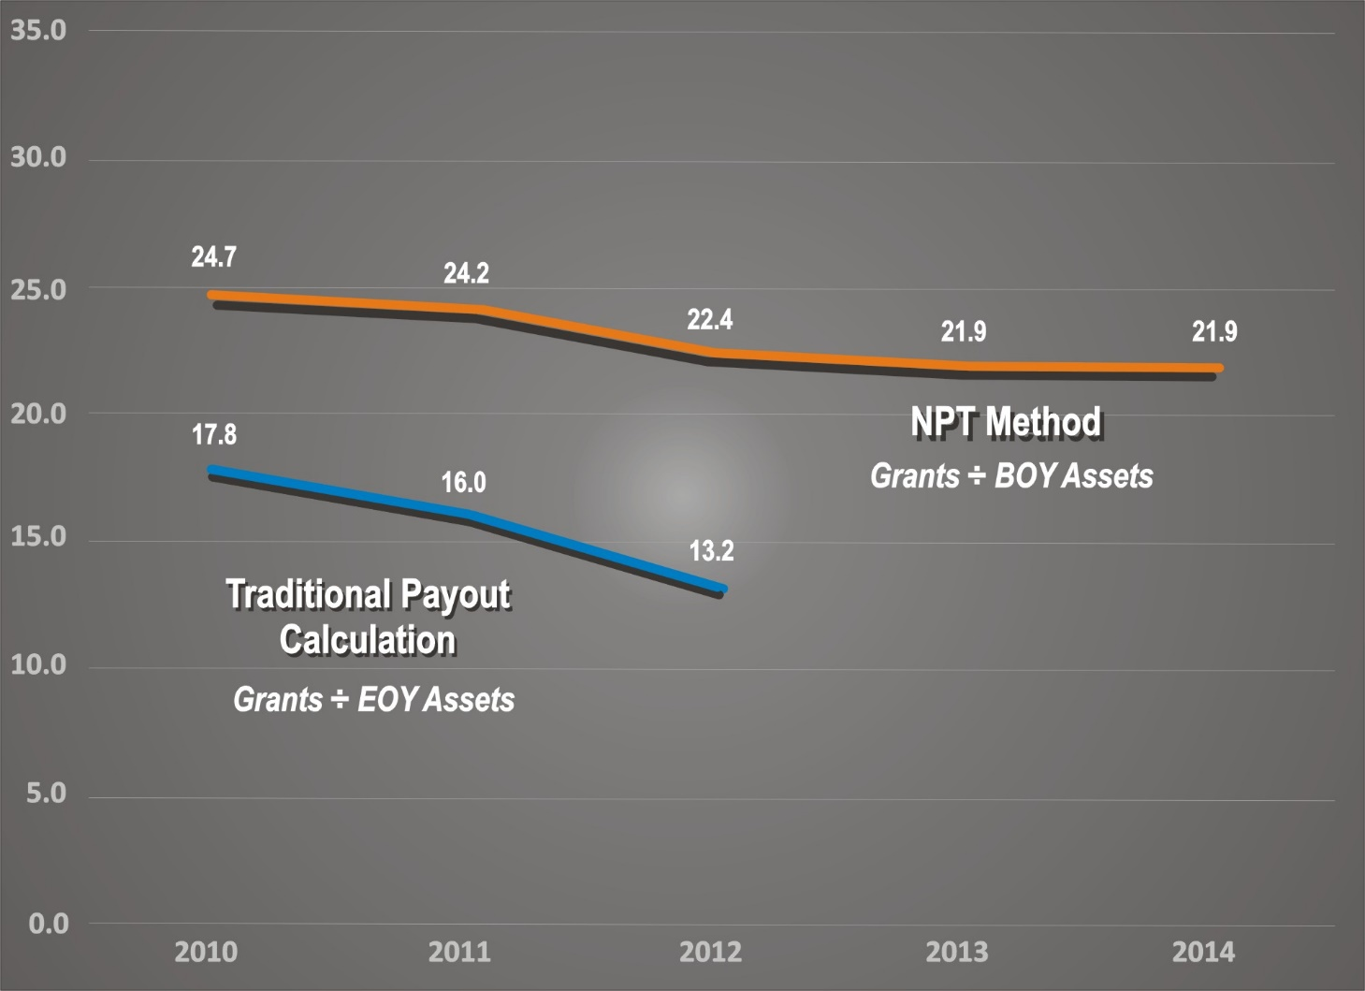
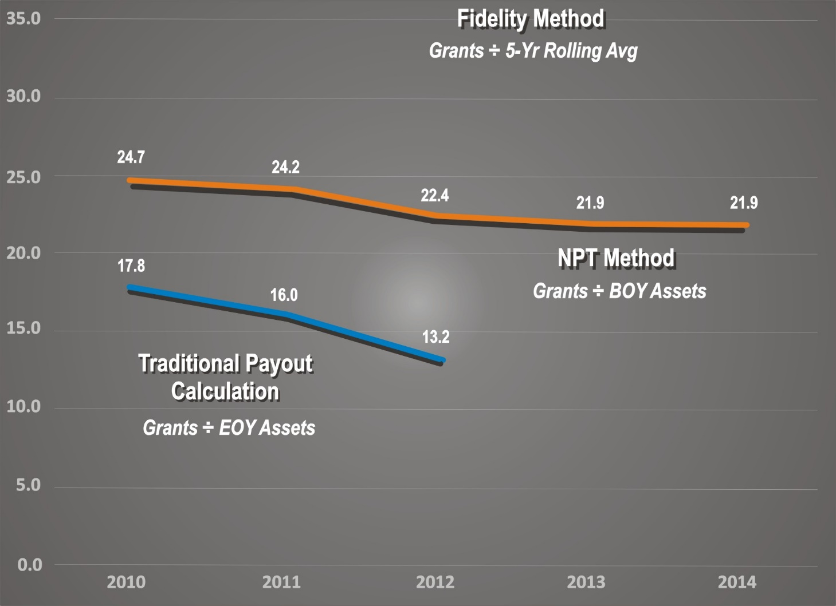
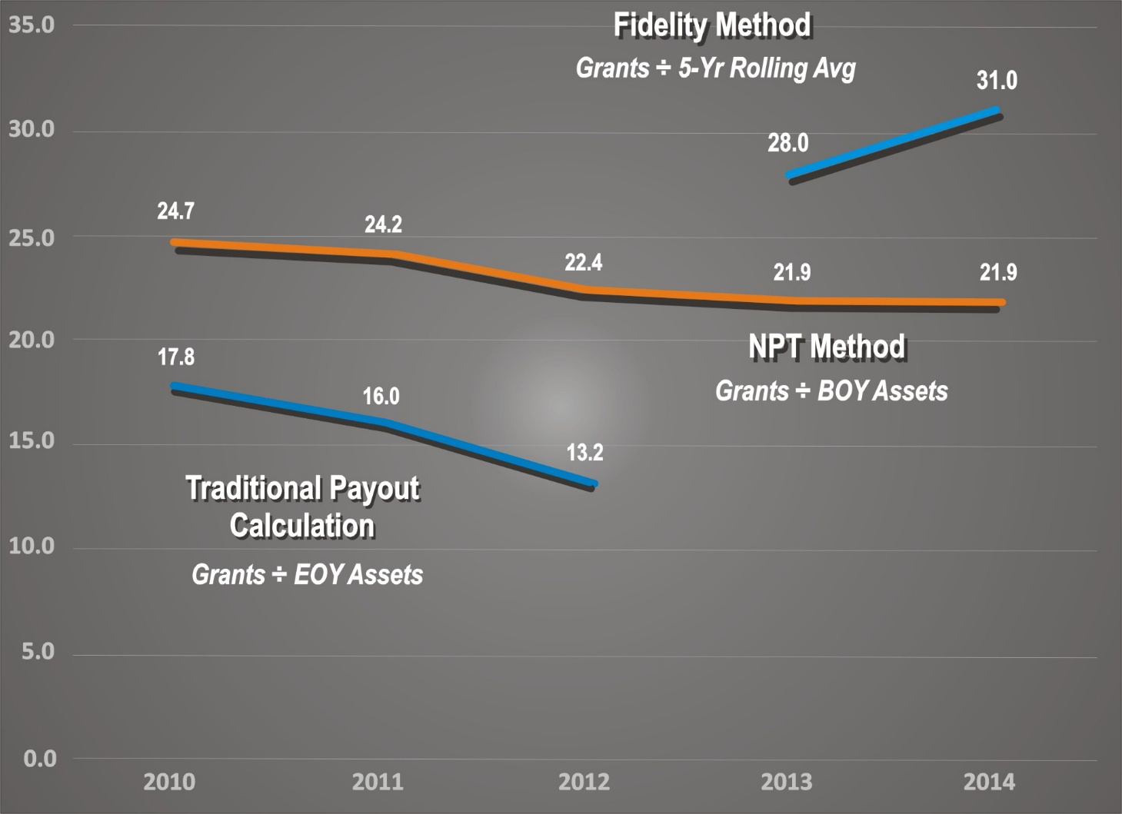

Slide 22
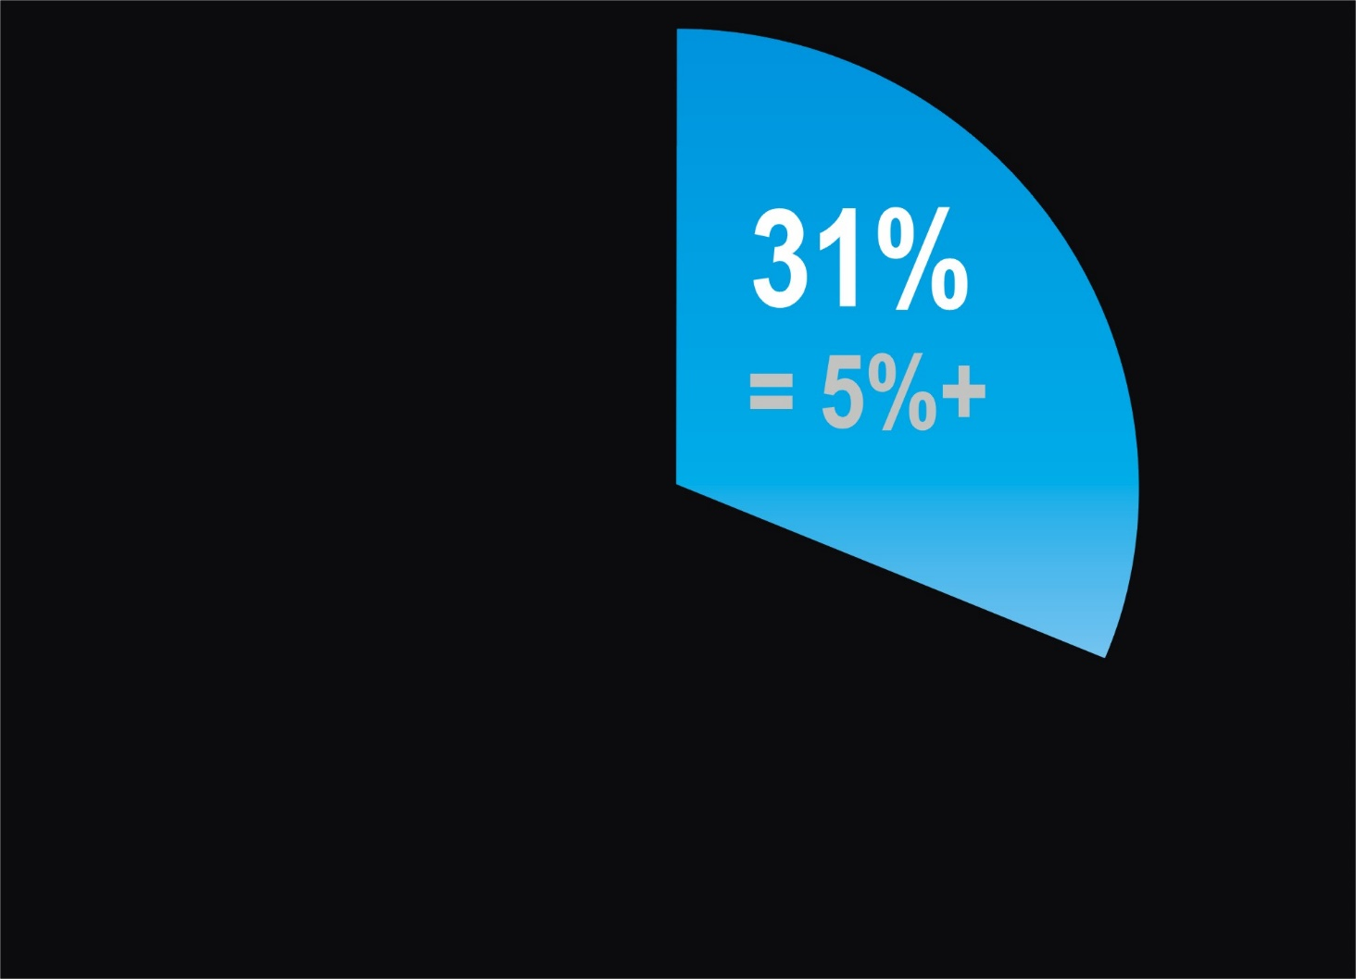
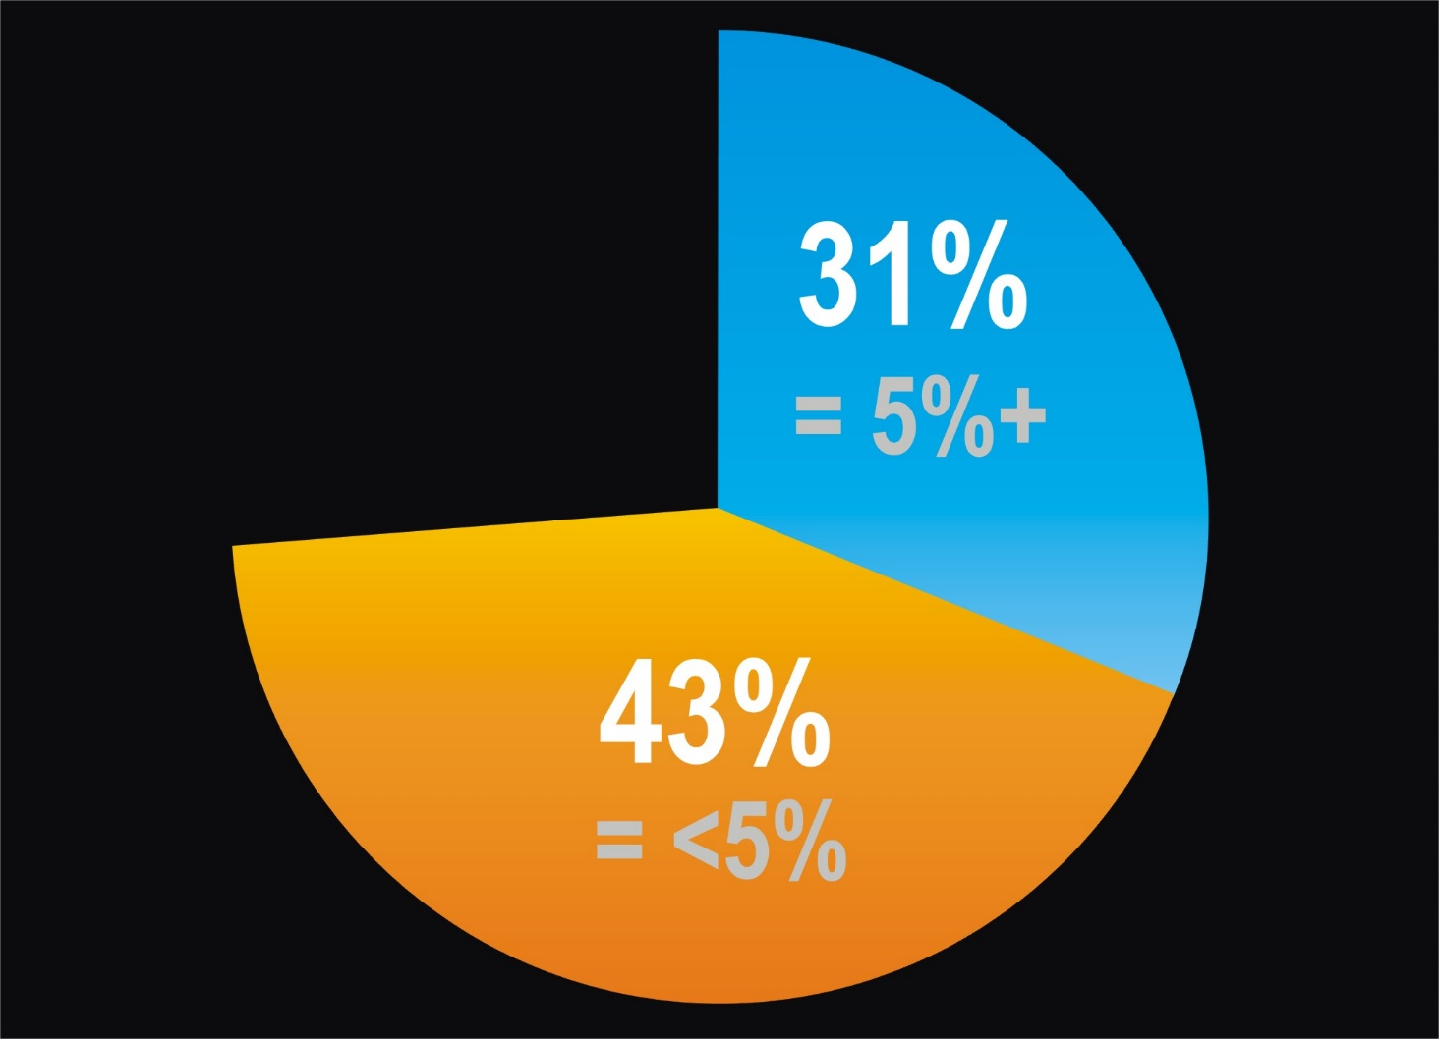
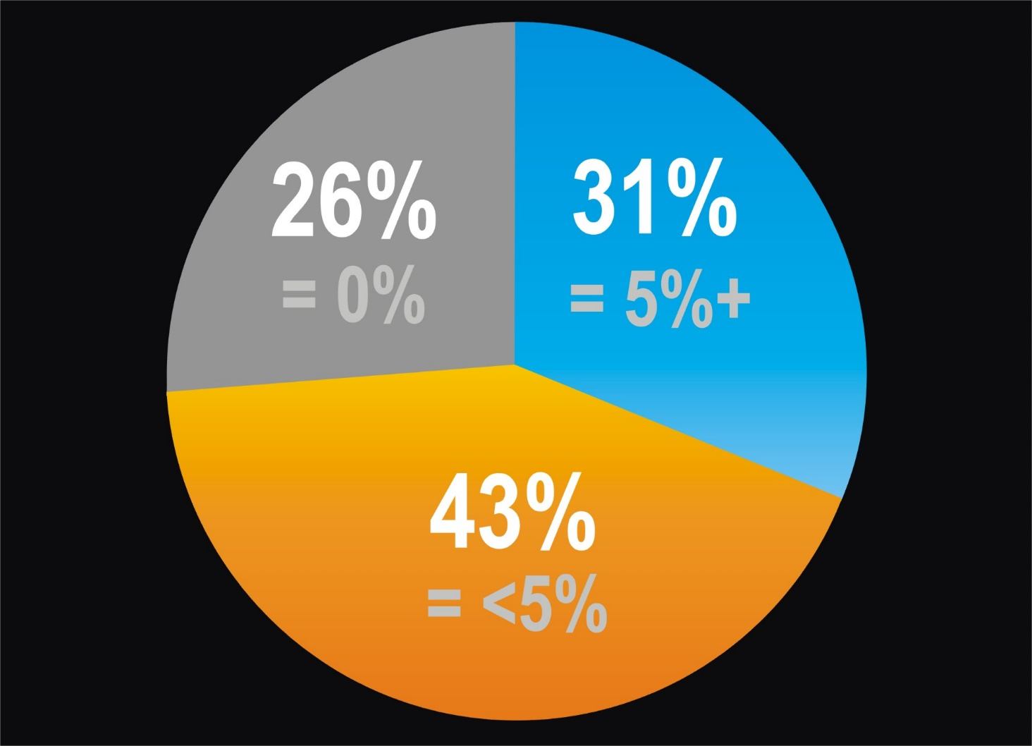
DAFs 2008
FDNs 2008-2011: 11.6% avg.

Slide 23
Criticisms of DAFs
Inhibits fundraising; donors inaccessible
Minimal transparency / disclosure (Allows “creative bookkeeping”)
Donor recommendations are non-binding (Donor has influence, but not control)
No distribution requirement (Diverts money from immediate charitable needs)

Slide 24
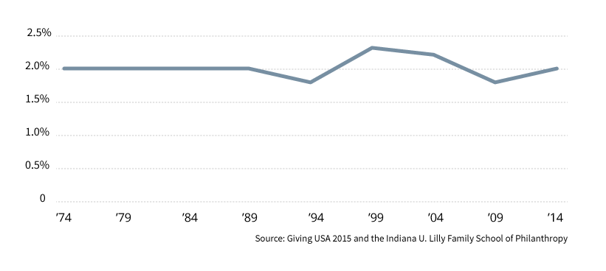
Directly to charity in 1989
Directly to charity in 2014
DAFs

Slide 25
Criticisms of DAFs
Inhibits fundraising; donors inaccessible
Minimal transparency / disclosure (Allows “creative bookkeeping”)
Donor decisions are non-binding (Donor has influence, but no control)
No distribution requirement (Diverts money from immediate charitable needs)
No incentive to encourage distributions (Accumulated cash = tax-free growth)

Slide 26
Are DAFs Taking Over the Charity World?
No.

Slide 27
Which is Best – DAF or Foundation?
It depends…
How much money does the donor want to invest?
How involved does the donor want to be?
How important are flexibility and control?
How important is anonymity or recognition?

Slide 28
DAF
FDN
Limited assets
Extensive assets
Minimal involvement
Major involvement
No management
Complete control
Anonymity
Recognition

Slide 29
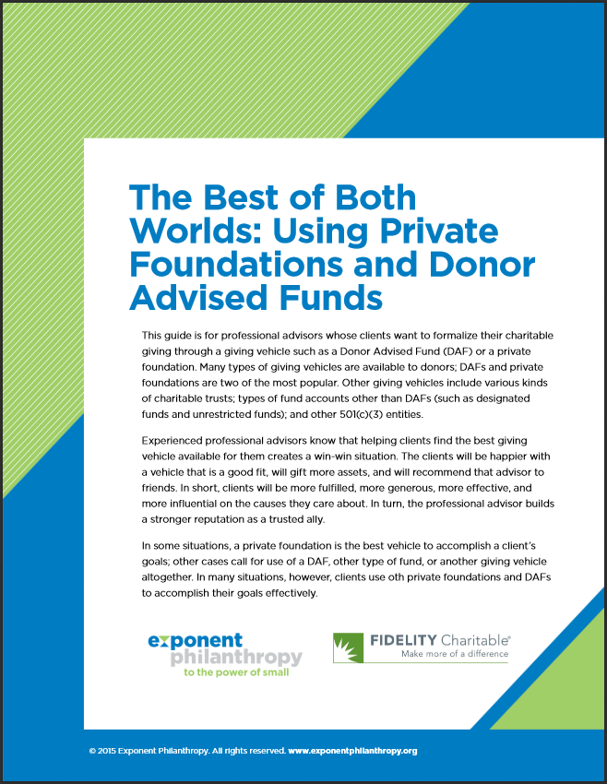
“Helping clients find the best giving vehicle available for them creates a win-win situation. In many situations, clients use a combination of both private foundations and DAFs to accom-plish their goals effectively.”

Slide 30
Donor-Advised Funds…
MAJOR GIFTS
or
CFR ???

Slide 31
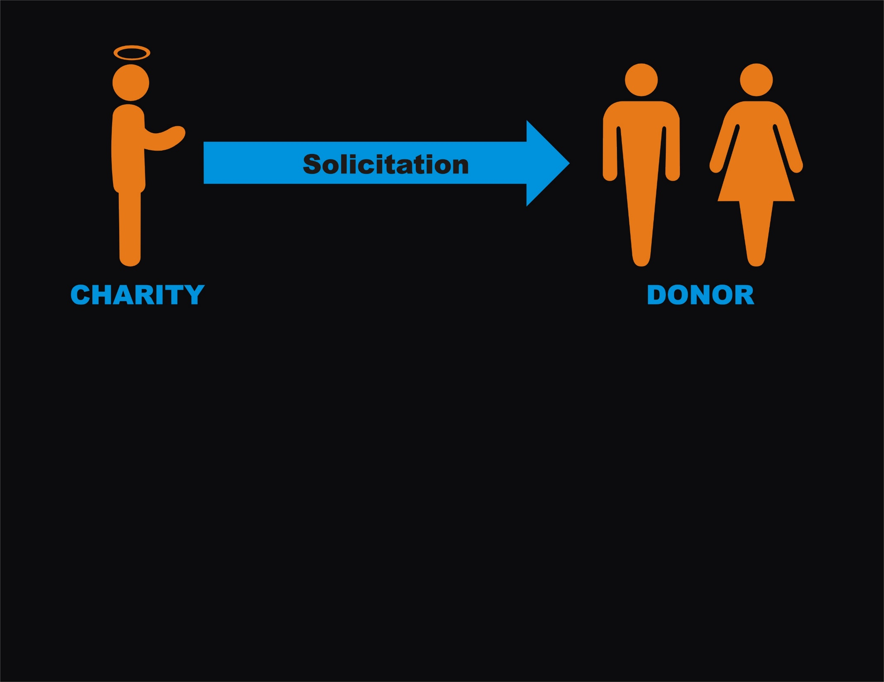
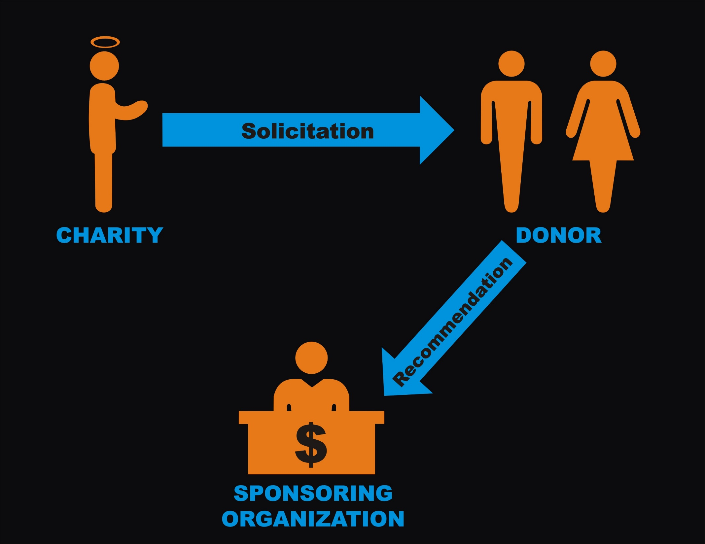
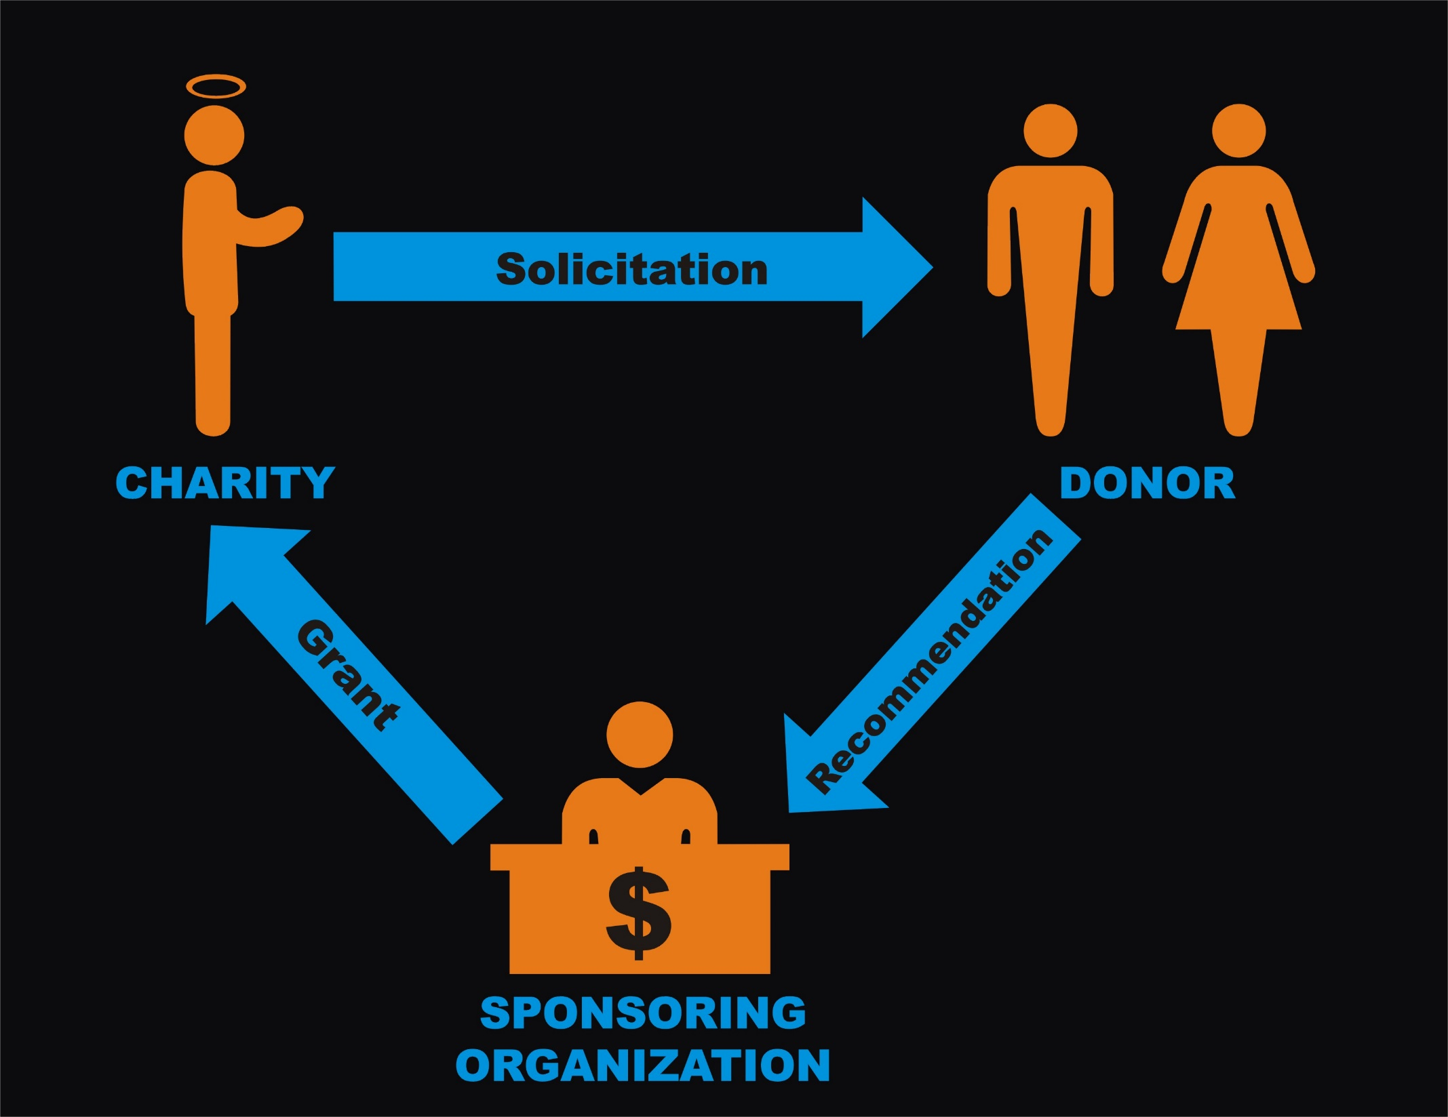
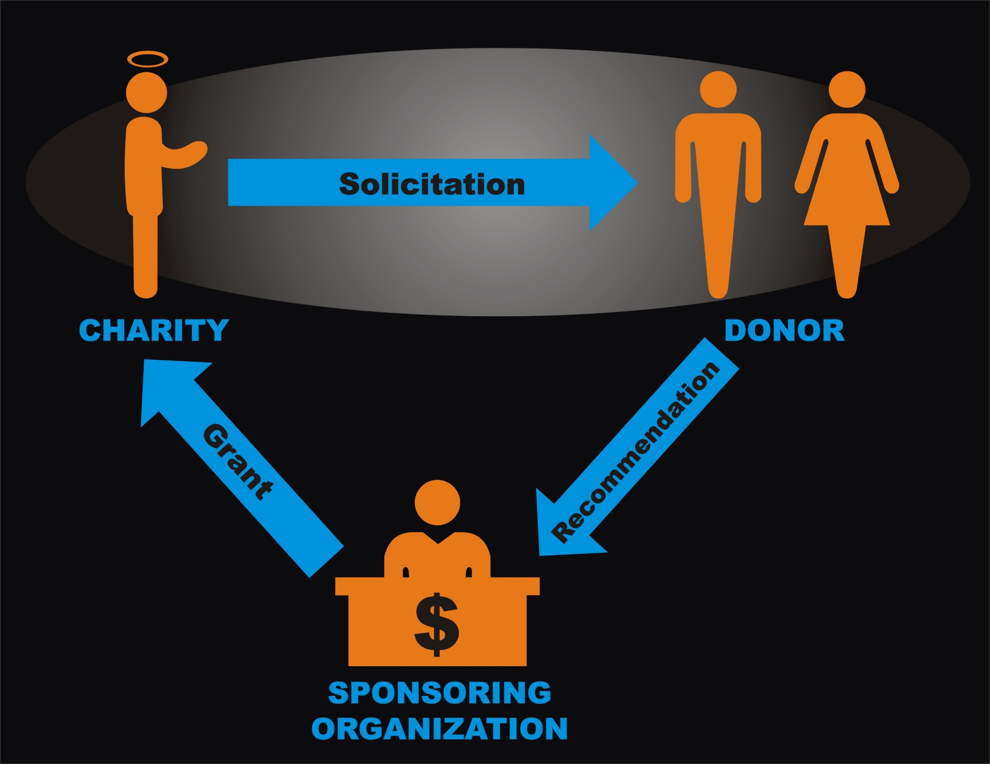
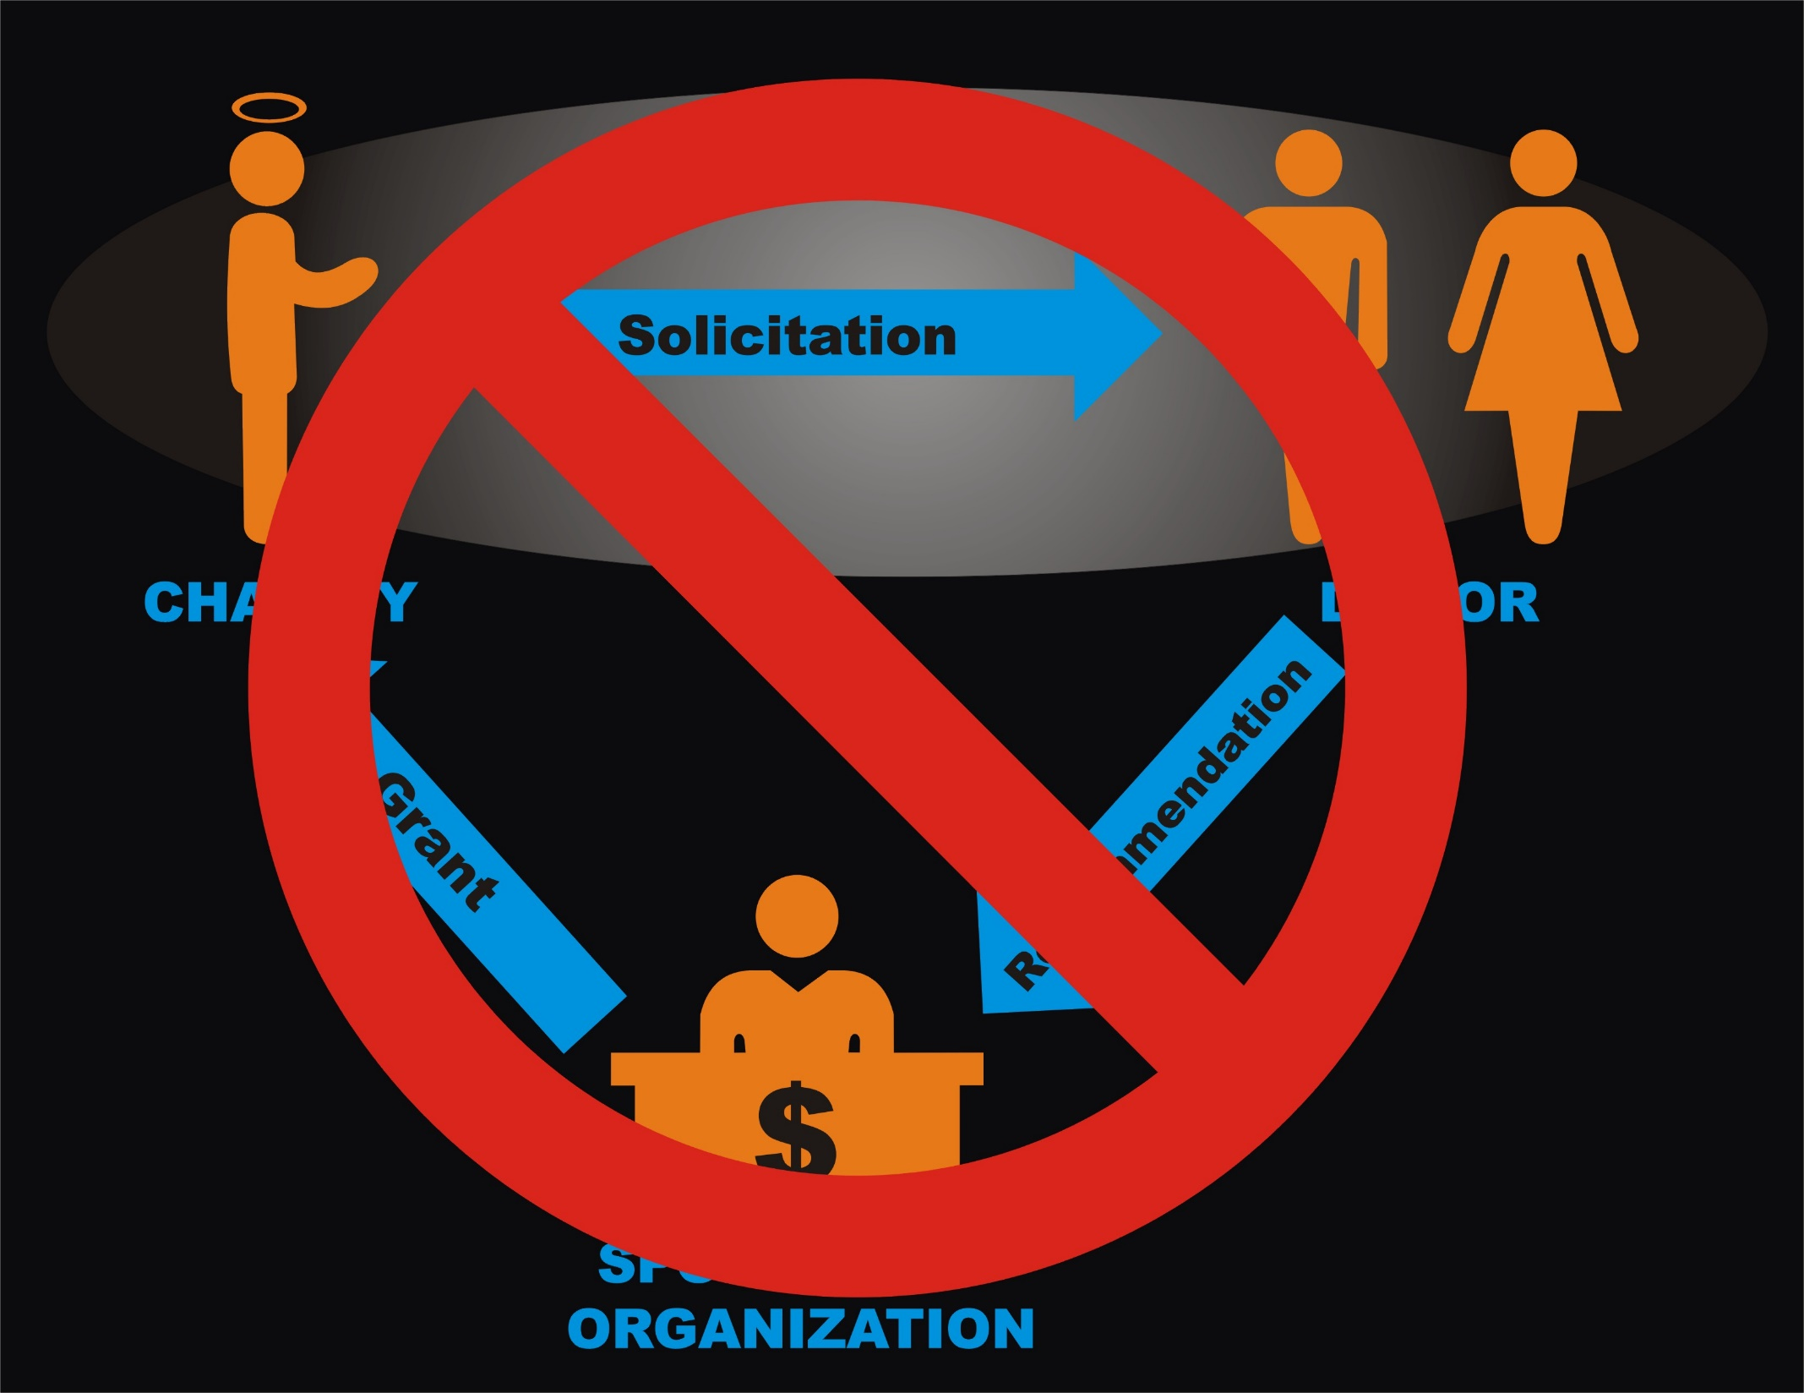

Slide 32
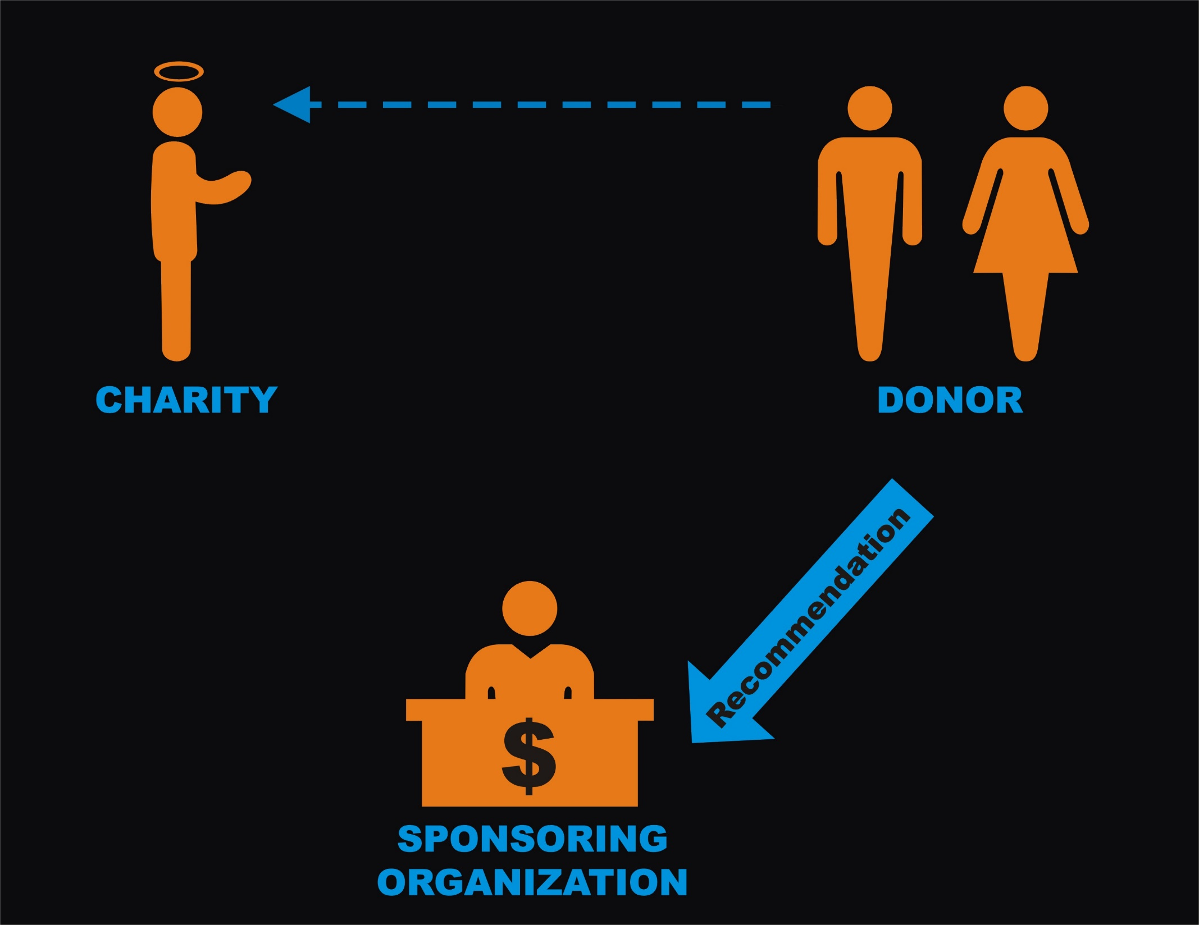
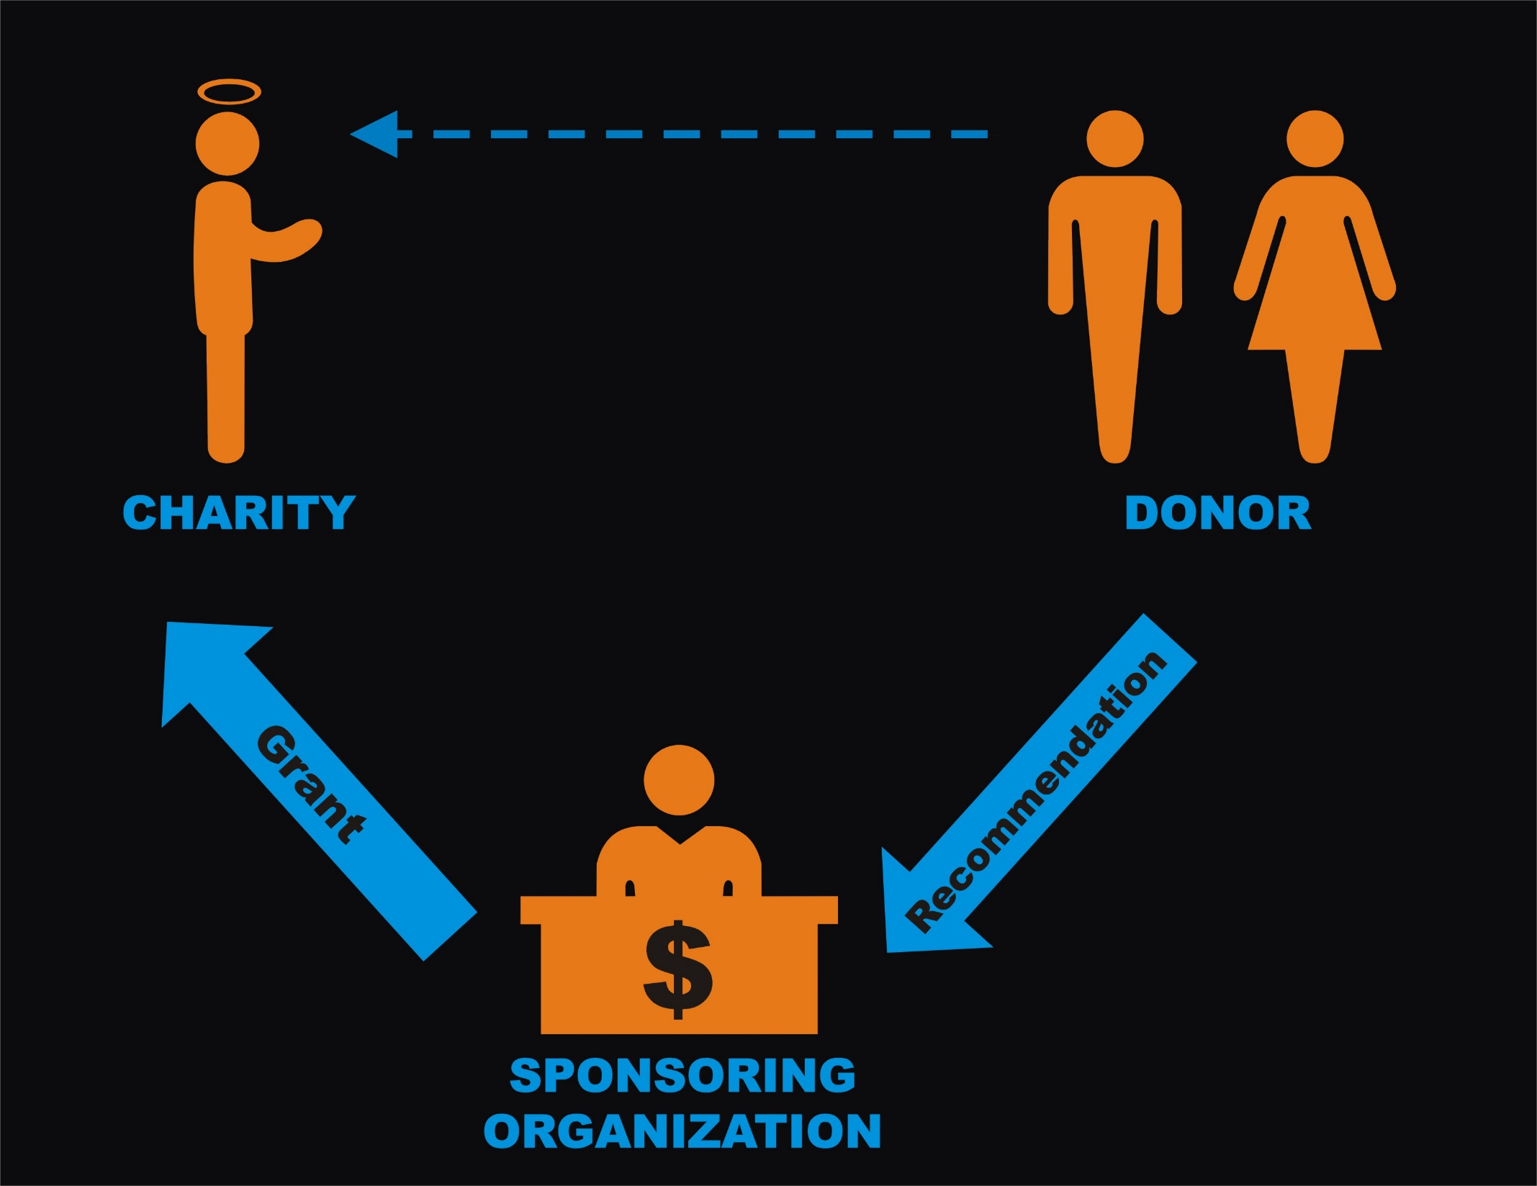

Slide 33
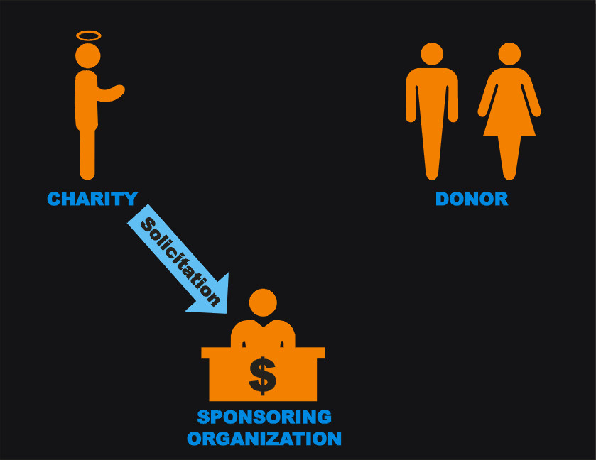
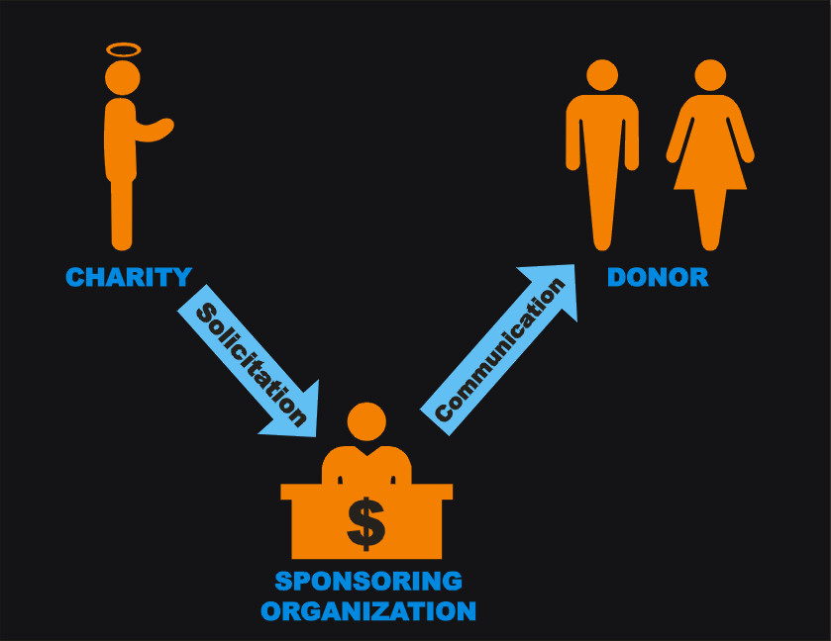
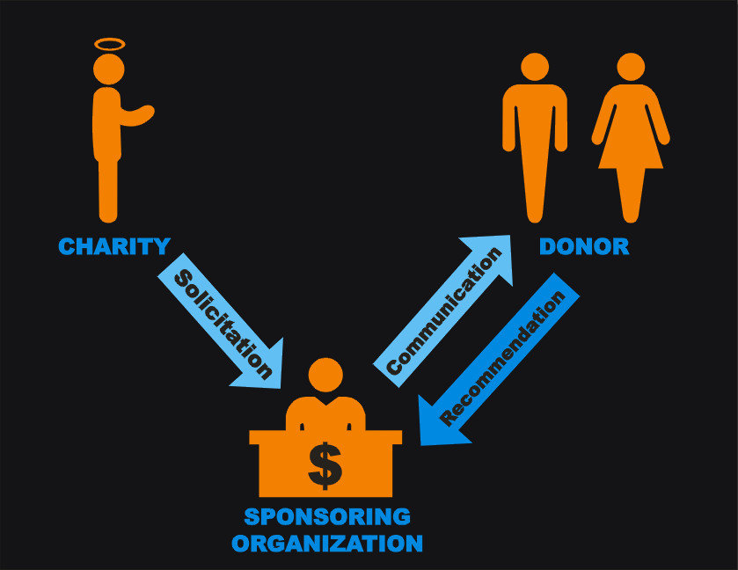
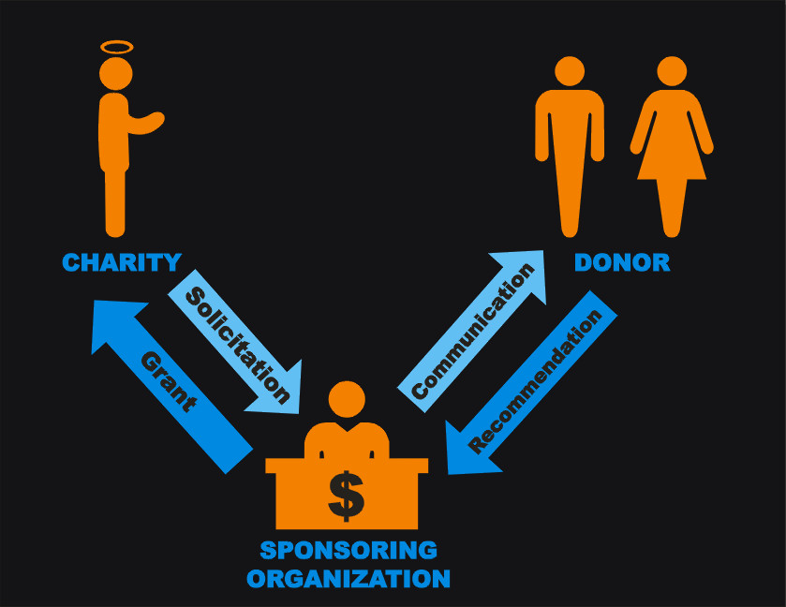
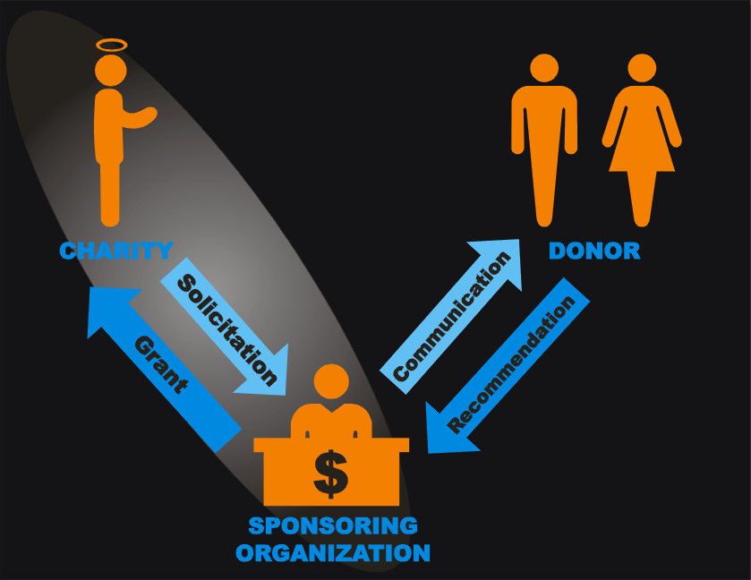

Slide 34
Why DAFs Fit Better with CFR than Major Gifts
In most cases, primary relationship is organizational, not personal
Many sponsoring orgs require follow-up report on DAF grants, just like foundations (Major Gift officers unused to this type stewardship)
Congress/Treasury moving toward regulating DAFs more like foundations

