Slide 1
APRA Texas

Slide 2
We have over 27 years of experience

Slide 3
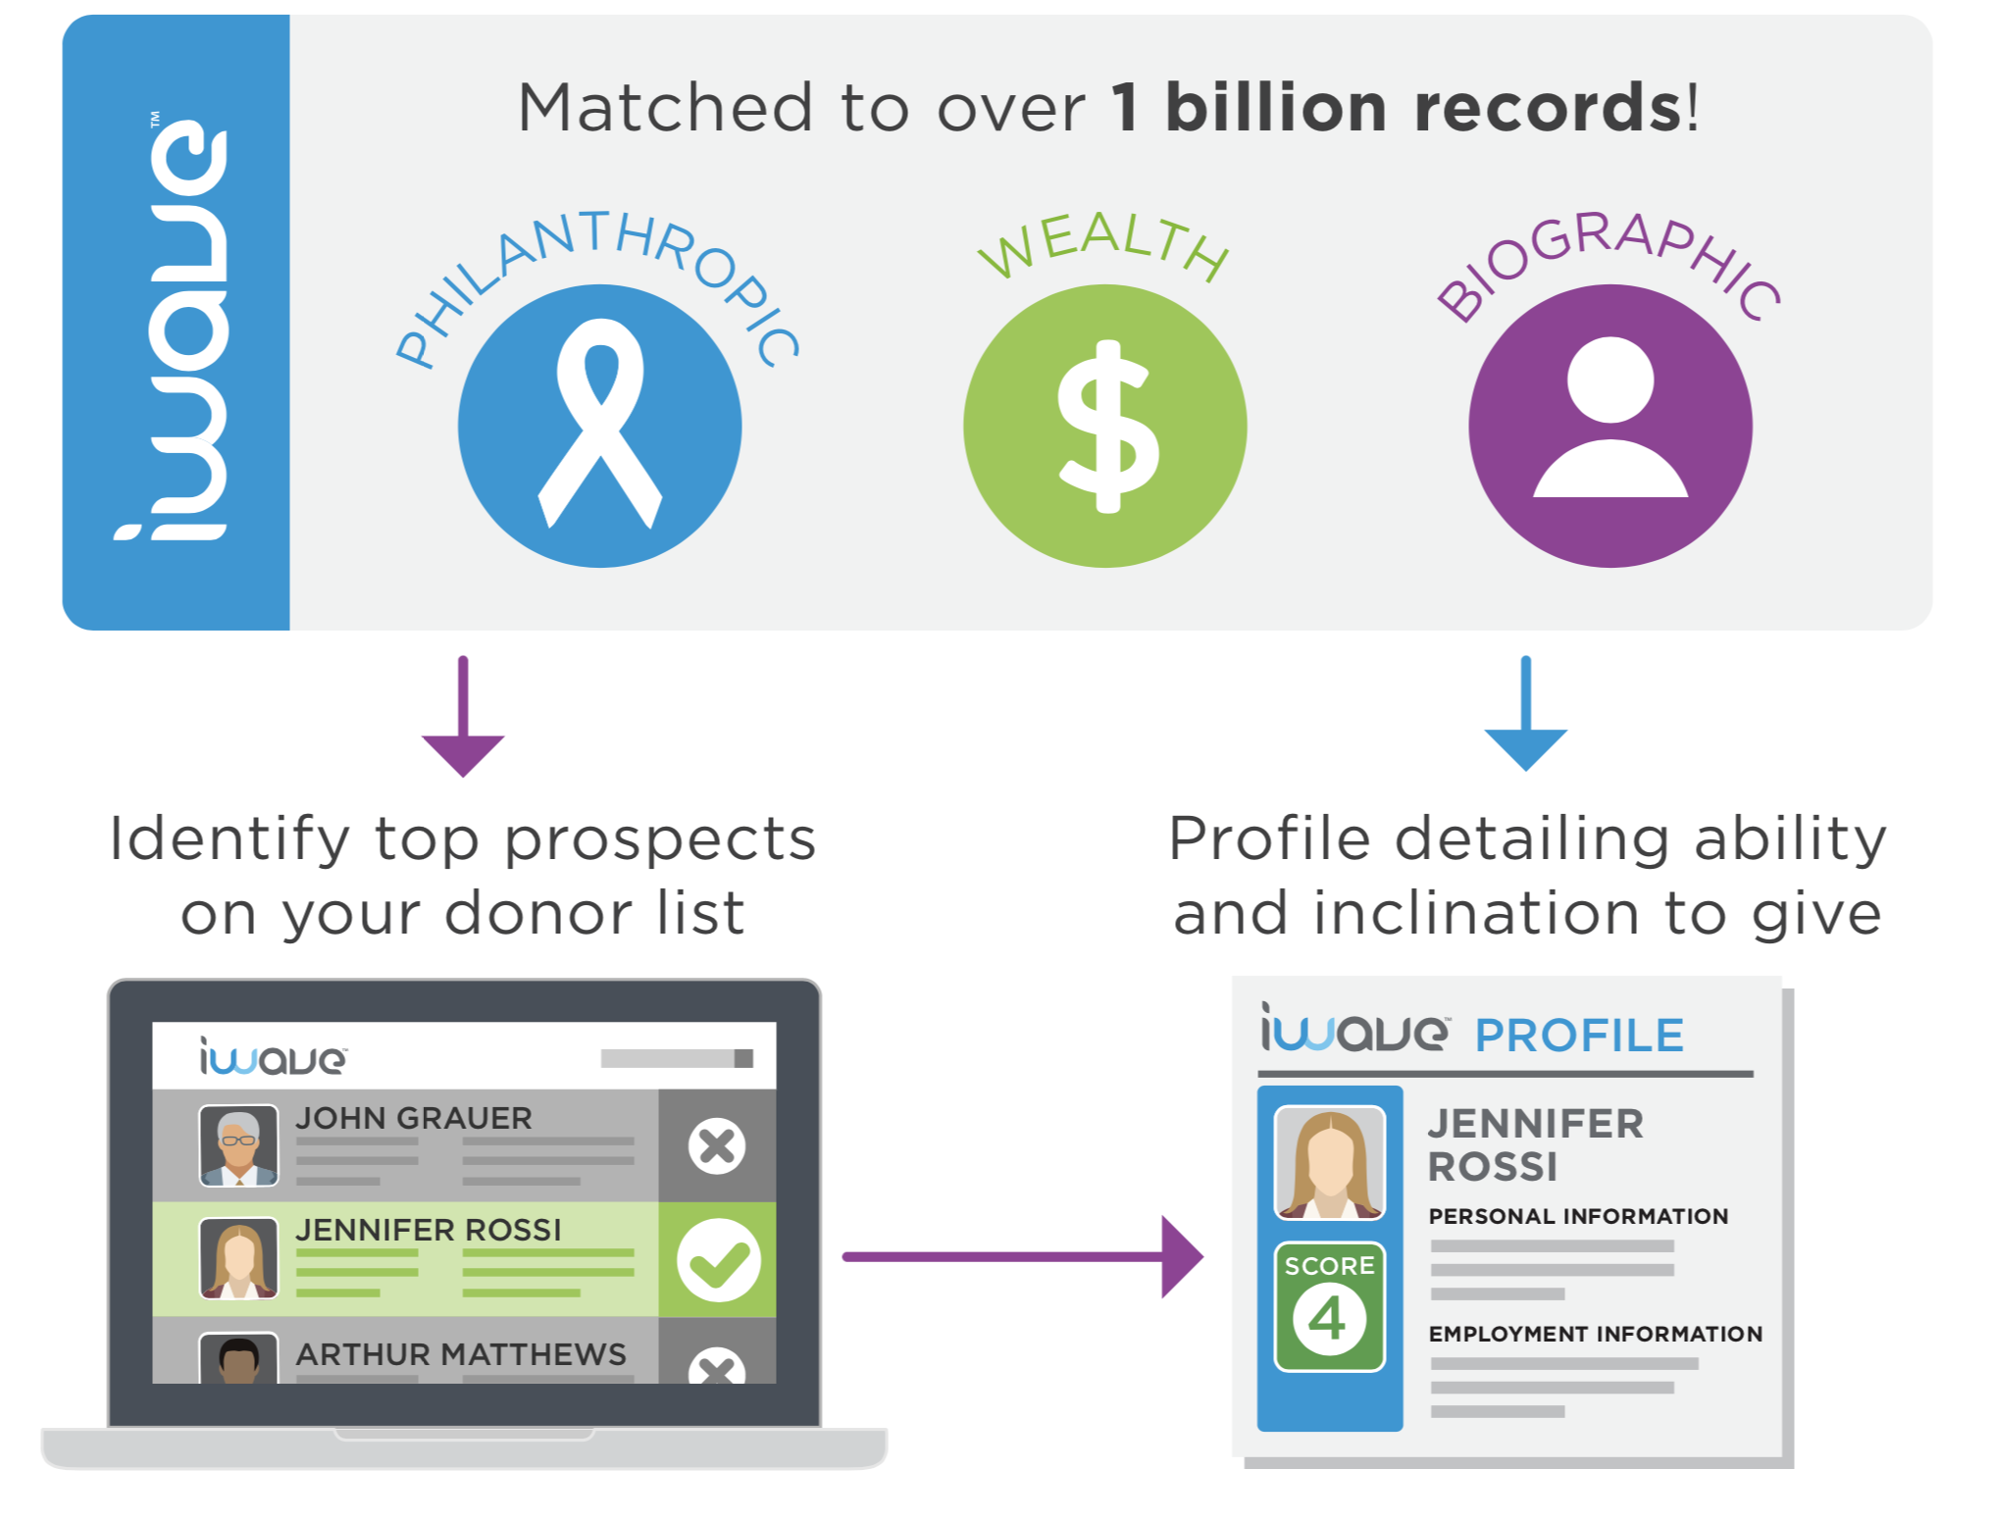

Slide 4

















Helping nonprofits fundraise with confidence

Slide 5

Case Study: Baylor University
BACKGROUND: Identify alumni and philanthropists who enjoy supporting educational organizations.
PROBLEM: Need Prospects in a new region, with a different affiliation.
SOLUTION:
Found a list of prospects in Dallas who had given major gifts to healthcare organizations
Prioritized list for people who already had a connection to Baylor
Added 8 prospective donors to gift table with a high gift level
Next Phase: Identify recipient of the past large gifts and review board members of organization for possible connections
Agenda Capacity Propensity Affinity Donor Profile Q&A

Slide 6






What’s New - Screening
Multiple Affinities
Providing organizations the ability to screen for multiple projects with one upload.
Thompson Reuters
Increased matching on stock information. In October, we added 46k individual records and 1k+ company tickers
Improved ability to discover biographical data and lifestyle interests.
Database USA

Slide 7
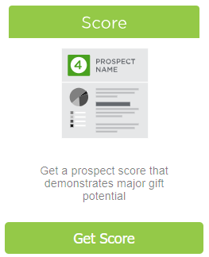
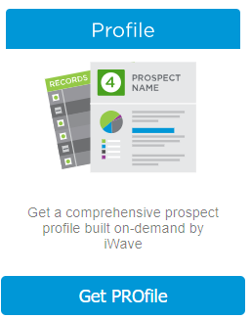
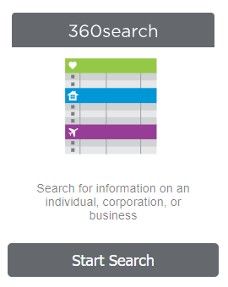
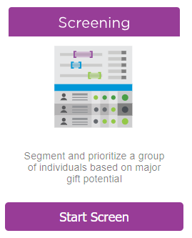

What’s New - Holistic Approach

Slide 8
APRA Texas; Thank You

