Slide 1
Maguire Energy
Institute
APRA North Texas Meeting
November 9, 2018

Slide 2
Topics for Discussion
Overview of North American Oil Markets
Oil Companies and Wealth Creation
Information Sources
Royalty Valuation
Discussion

Slide 3
North American Oil Markets
Crude is off $15 per barrel from is mid $70s high in the summer
  Seasonal
  Iran sanctions being dampened by exemptions
  Increased supply
  Demand concerns
Long term outlook is still bullish – $60+
Permian Basin is center of the US industry
  Wells declining faster than anticipated
  Economics work down into the 40s
  Most private and public capital is going into the Permian, though other Basins are warming up

Slide 4
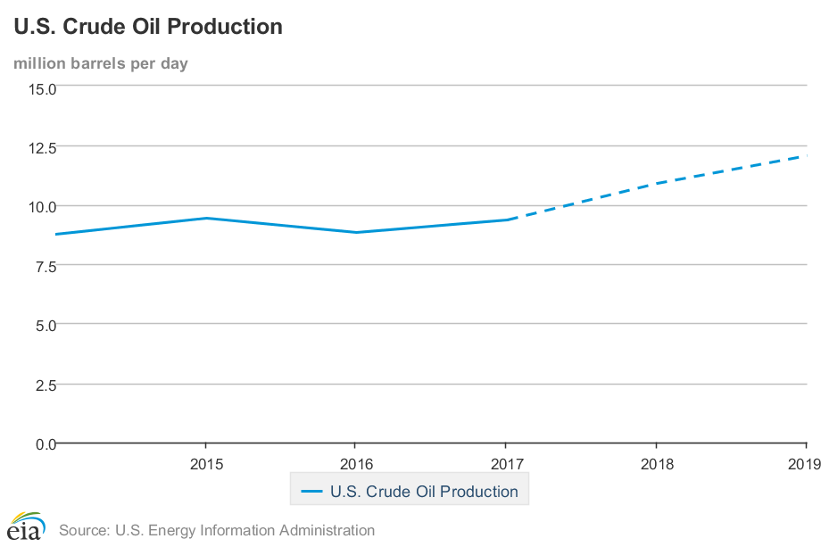
North American Oil Markets

Slide 5
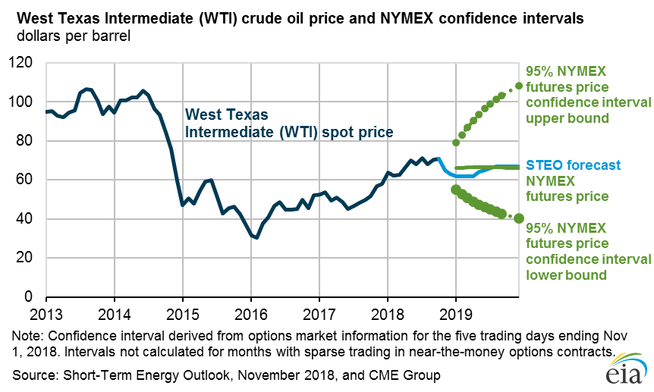
Oil Prices

Slide 6
How do oil companies create value?
Explore for potential minerals through seismic, record searches etc.
Acquire mineral rights through leases
Drill exploratory wells – determine results
Drill development wells
“Prove Up” the property – determine the reserves and the value
An independent petroleum engineering firm provides a “reserve report”
Reserve report provides an assumption on how much oil can be economically produced at forecasted prices and with certain assumptions such as how fast the wells will decline etc.
Value is the NPV or Net Present Value of the forecasted cash flows.
The company can either produce the field, sell the field, or enter into a joint interest agreement to partner with others.

Slide 7
You have this property in hand. What do you do with it?
The proved reserves – those with a 90% probability of being economically produced are put on your balance sheet as assets.
If you are a small company, you will need need capital to produce it.
  Debt markets
  Equity markets – IPOs
  Partners
Ultimately that property is either produced, held for the future, or sold.

Slide 8
So what is the value?
If its produced, it’s the proved reserves on the balance sheet.
  Public companies – 10K (PV10)
  Private companies or entrepreneurs – difficult to find
If its sold – it’s the transaction price
  A little easier to find
  Oil and Gas Investor Magazine
  Investment bank and analyst reports
  DrillingInfo service
  Bloomberg
  Thomson Reuters Eikon
  Google
If its neither – look for comparable transactions
  Same commodity
  Same basin
  Same county
  Same acreage
  Within the same year
  Other similarities
  Look through the same basic sources

Slide 9
Three players in the markets
Public companies
  Pioneer
  Anadarko,
  ExxonMobil
Private Equity Backed Companies
  NGP (sponsor)
  Encap (sponsor)
Private companies

Slide 10
Strategies Prior to 2017
Public Companies
  Find and produce
Private Equity Companies
  Prove up, drill 3 to 4 years
  Sell to public company
  IPO to capital markets
Private companies
  All of the above

Slide 11
Post 2017 – IPO Market Closed
Public Companies
  Find and produce
Private Equity Companies
  Prove up, drill
  Sell to another private equity company
  Wait for public capital market valuations to improve
Private Companies
  All of the above

Slide 12
Royalties
The source of most mineral holders wealth
A lease provides two major compensation components
  Royalty – used to be 1/8 of revenue. 1/5 now standard
  Bonus --$/acre. Amount depends on field, market cycle etc. Can range from $500 to $10,000.

Slide 13
Valuing Royalties
Very difficult
While leases are public information in the county of record and most leases are on sources such as DrillingInfo etc., the “real compensation” is confidential.
The true bonus and royalty is usually in a side agreement or letter for competitive reasons – companies don’t want other companies knowing what they pay royalty owners

Slide 14
Ways to Calculate Royalty Information
NPV of the production stream at a price forecast times the royalty rate.
  Information is difficult to find.
  Bonus can be higher than the royalty in early years as its cash to the mineral owner.
  Production rate available from DrillingInfo or the state regulatory web site
  Don’t know the rate.
WAG method – 3 to 5 times the annual royalty payment
  $12 million in annual payment per year. Property may be worth $36 million to $60 million in net worth.

Slide 15
Ways to Calculate Roylaty Information
Comparable Transactions
Look for comparable transactions
  Basin
  Profile of production
  County
Compare comparable transactions – take 20% of it for the royalty approximation.
Remember – that’s a value. The royalty owner continues to receive payments, not a lump sum.

Slide 16
Example

Slide 17
Implication for Development Purposes
Landowner may not be the mineral owner. Title search often required.
Difficult to calculate a precise value but you can ballpark.
Royalty payments fluctuate with the markets
Wills and trusts can be a nightmare – the acreage can be split multiple ways with heirs fighting. Oil and gas lawyers are worth the price.
Private equity backed company CEOs and officers frequently have much of their own wealth tied up in their company – by requirement of the PE sponsor. Their wealth occurs when they are bought.

