Slide 1

APRA North Texas –
Target Analytics
Chanler Cox, Account Executive

Slide 2


A total set of solutions:
Direct Marketing
Data Enrichment Services
Solutions to expand your omni-channel marketing communications through the use of strategic outreach – we help identify the individuals that will respond best through each outreach channel.
Acquire
Database services to update, maintain, and expand your constituent profiles to adhere to USPS standards, improve fundraising, and prepare for effective analytics.
Connect
Performance Analysis
Understand
Optimize
Research & Modeling
Benchmark fundraising effectiveness, learn best practices from peers, and implement proven strategies for performance improvement.
Enhanced modeling, data insights, and software solutions to find the right prospects and connect with the right message.
2

Slide 3
Predictive Modeling
Wealth Screening
Target Analytics Affluence

Slide 4








Target Analytics Affluence
Target Analytics Affluence extracts ACCURATE, ACTIONABLE wealth attribute data from across
the US population and uses it to organize prospects into precise donor groups and segments.
4 Wealth Attributes
5 Donor Groups | 13 Segments
Annual
Income
A. Philanthropists
B. Humanitarians
Net Worth
C. Casual Donors
Investments
D. Enigmas
Discretionary Spending
E. The Masses

Slide 5
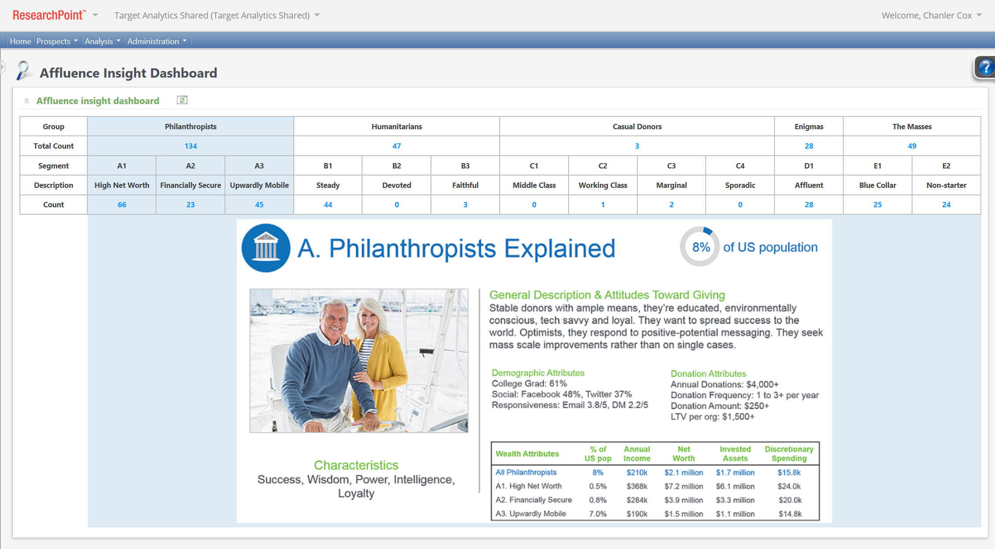

Slide 6




Thank you

